Slide 1
STW LCS Anticipated Roll-Out
No. | Cohort | Invitations | LHCs Commence | Scans
1 | Telford & Wrekin South | Dec 2025 | Dec 2025 | 14 Jan 2026 – Apr 2026
2 | Telford & Wrekin Central | Mar 2026 | Apr/May 2026 | May - Sep 2026
3 | Telford & Wrekin North Linden Hall Surgery Wellington Road Surgery | Aug 2026 Sep 2026 | Aug 2026 Oct 2026 | Sep/Oct 2026 Nov/Dec 2026
4 | Shrewsbury North | Nov 2026 | Nov/Dec 2026 | Jan – Apr/May 2027
5 | Shrewsbury South | Mar 2027 | Apr 2027 | May – Aug 2027
6 | Shropshire North-West | July 2027 | Aug 2027 | Sep 2027 – Feb 2028
7 | Shropshire North-East | Nov/Dec 2027 | Jan 2027 | Feb – Apr 2028
8 | Shropshire South-West | Mar 2028 | Apr 2028 | May – Aug 2028
9 | Shropshire South-East | Jun 2028 | Jul 2028 | Aug 2028 – Jan 2029
10 | Shropshire Rural | Nov/Dec 2028 | Jan 2029 | Feb 2029 – Mar 2029

Slide 2
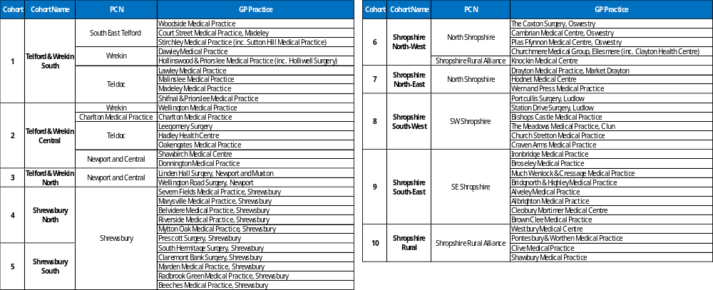
Cohort Allocation – GP Practice

