Slide 1
Shrewsbury Health and Wellbeing Hub
Focus Groups – May 2022

Slide 2




Housekeeping
Please turn microphones and cameras off during the presentation.
Feel free to ask questions or make comments in the
chat function at any time.
We will answer questions in the chat after the presentation, and invite others.
If you are experiencing technical problems, please type the issues into the chat function.
Notes:
Microphones and camera/ technical issues/ broadband speed and bandwidth. IT…. If you require speech to text interpretation you can get this by clicking……

Slide 3
Aims of today
To present the programme aims for general practice in Shrewsbury
To discuss GP practices in Shrewsbury and hear your views on using their services
To explain how general practice is changing and why it needs to change
To discuss the proposed new Health and Wellbeing Hub and understand your views on this.

Slide 4
Introduction to our ICS
Shropshire, Telford and Wrekin Integrated Care System (ICS) is a partnership of health and care organisations working together to deliver better, more joined-up services for local people
From July 2022, Shropshire, Telford and Wrekin ICS will become statutory
We have ambitious plans to improve outcomes, care for local people and reduce pressures on services for the county
The proposed Shrewsbury Health and Wellbeing Hub matches the aims of the ICS, plus we will own the new building.

Slide 5
Programme aims
Improving safety and quality: Making sure our services are clinically safe and tackling the backlog of elective procedures ​
Integrating services within the community: Developing local health and care hubs to improve the physical and mental health of people, better manage hospital admissions, and establish new models of care to best serve our communities
Tackling ill-health, health inequalities and access to health care
Economic regeneration: Contribute to innovation, productivity and good quality work opportunities to create economic prospects that will help improve the health and wellbeing of our population ​
Workforce stability: Making our health and care system a great place to work.

Slide 6
Timeline so far
Progress
so far…
2021
2022
Early 2021
23 Aug – 26 Sept
Winter 2021/22:
May
(today)
Communications and Engagement Working Group was established with representation from key partners.
Recommendations from the group have fed into the Engagement Plan.
Case for Change developed – informed by listening exercise
First phase of engagement – listening exercise including online survey and telephone interviews.
Second phase of engagement – focus groups to discuss the Case for Change.
Sept – Oct
Patient and Public Advisory Group (PPAG) was established and met to review the feedback gathered.

Slide 7
GP practices in this area
Presenter: Emma Pyrah

Slide 8
The changing face of general practice
General practice is the first contact in the healthcare system
GP patient lists are growing: An average of 2,461 in 1948; but closer to 9,000 today
Life expectancy is increasing: Long-term conditions are prevalent like diabetes and obesity
Treatment has progressed: From single physical appointments to a greater focus on mental health, preventative care and managing long-term conditions
The buildings used for GP practices:
  Typically converted from houses and cannot be extended or modernised to meet future demand or accommodate other services
  50% are owned by GPs, 35% by private landlords, and 15% are owned by one of the two NHS property companies
  These buildings cost the NHS approximately £940 million a year and are therefore not the best use of taxpayers money.

Slide 9
The GP practices involved in this programme
The Beeches Medical Practice, Belvidere Medical Practice, Claremont Bank Surgery, Marden Medical Practice, Marysville Medical Practice ​and South Hermitage Surgery have said they want to relocate fully to the hub
Radbrook Green and Mytton Oak surgeries will offer extended services
Most of the practice buildings are no longer fit to deliver modern healthcare services and/or do not have enough space to meet future demand
Running costs (e.g. rent and maintenance charges) for buildings ran by private landlords have also made some buildings unaffordable
We want to allow for more flexibility of the workforce to deliver continuity of care and improved access for patients – particularly those with complex health needs
We want to ensure general practice in Shrewsbury is fit for the future and the best it can be for our patients.

Slide 10
Why we need to change and the benefits of change
Presenter: Dr Charlotte Hart

Slide 11
The need for change
Financial and operational pressure: ​We must plan with the resources that we know we have access to, to meet the needs of our patients. If action is not taken now, more difficult challenges will be faced in the future and some practices will become unsustainable
Rising demand: With the increasing pressures, targets for planned care are not being met and the number of available beds in the NHS continues to fall. The strains on capacity will only get worse
Recruitment and retention: We must retain our hard-working, dedicated clinical and support staff. We need to offer attractive conditions so we can recruit in the future
Need to collaborate: ICSs are a new opportunity to work together to deliver better health and care services
Need to take decisive action now: NHS performance is significantly challenged, and isn’t likely to change in the near future.

Slide 12
Benefits to patients
More quality services in one location, with modern facilities: Some services will be able to move out of hospitals and into communities, improving access and efficiency
New technologies, research, learning, and new ways of working: Joined-up services will improve professional relationships and provide more opportunities for shared learning
Supporting patients: Access to all parts of care under one roof
GPs can focus on delivering care instead of running the buildings: Modernisation of the estate will ensure assets and value are retained – as well as a sustainable future
Reduced health inequalities and improved clinical outcomes: Rather than just treating illness, the hub would support the health and wellbeing of residents
Quicker access to appointments: A more resilient and diverse workforce means more people available to support you when you have a medical need.

Slide 13
Discussion one | your experiences and views
What do you think about these aims and benefits?
(likes and concerns)
What ideas do you have to respond to these challenges?
What are your experiences of general practice? (likes and concerns)

Slide 14
The future for the six GP practices:
The Shrewsbury Health and Wellbeing Hub
Presenter: Dr Charlotte Hart

Slide 15
The Shrewsbury Health and Wellbeing Hub (1)
Shropshire was chosen as one of six pilot areas in England – marking substantial and much-needed national investment
The hub would involve the co-location of practices alongside other health, social care and voluntary and community services
Enabling individual practices to work in a building with other services on site will help to improve levels of access across these services, help to promote proactive and coordinated care across services, enable multidisciplinary working and innovative approaches
A building owned by the NHS will be more cost effective for practices as they won’t have to pay high rent and maintenance charges to private landlords.

Slide 16
The Shrewsbury Health and Wellbeing Hub (2)
Services will be matched to the needs of local people
Additional facilities will increase the number of services provided in the community
It is a priority to retain our clinical and support staff - to offer attractive conditions, a solution that works best for our current workforce, is sustainable and future-proof
A state-of-the-art building will provide high-quality, modern healthcare facilities which meet changing needs
Similar models of care have worked well – improving quality of care, increasing number of appointments, reducing unnecessary referrals, and providing better continuity of care.

Slide 17









Vision and guiding principles (1)
Our vision for what could change with the development of a new health and wellbeing hub:
Additional facilities will increase the number of services provided in local community settings,
in line with the NHS Long Term Plan (2019)
Additional facilities and services could include:
The state-of-the-art building will enable us to provide high-quality, modern healthcare facilities which are flexible and future-proof to meet changing needs
6
1
More appointments
6x
The new hub would bring the six local GP practices together alongside other health, social care, voluntary and community services
Healthcare professionals working together [more multidisciplinary working]
5
Improved access to care
2
Mental health and other services on site
4
3
Better diagnostics on site
Notes:
6x

Slide 18



Vision and guiding principles (2)
Our vision for what would stay the same with the development of a new health and wellbeing hub:
The practices will remain as six separate practices
– all retaining their own identity and independence
Your GP practice will still be in charge of your records and know your history
Your GP will stay the same

Slide 19
Potential services in the new hub
Contraception and sexual health
Dermatology
Podiatry
Community nursing
Pharmacy
Minor operations
Diabetes management
Tissue
viability
Midwifery
COPD management
Outpatients
Audiology
Physiotherapy
Counselling services
Rheumatology
Shropshire Orthopaedic Outreach Service
Diagnostics, Assessment and Access to Rehabilitation and Treatment
Community dental
Ophthalmology and retinal screening
Notes:
The Shropshire Orthopaedic Outreach Service (this is the physio service that all patients referred to the Robert Jones and Agnes Hunt Orthopaedic Hospital must go through before they are put in front of an orthopaedic surgeon. It is an outreach service and already functions from Shrewsbury and all the other rural towns across Shropshire.
DAART is the Diagnostics, Assessment and Access to Rehabilitation and Treatment service run by ShropCom. It already has a set up in Robert Jones Agnes Hunt

Slide 20
Community-based services
Paediatric outpatient services
Maternity hub
Musculo-skeletal
Cardiology
Pulmonary rehabilitation
Mobile diagnostic vehicle

Slide 21
Discussion two | your thoughts on the plans
What are your views on the plans?
(likes and concerns)
Is there anything else
we should consider?
(both positive and negative impacts)
What other services would you like to see in the hub?
(e.g outpatient services, preventative services, services to support people entering and leaving hospital, or community –based services.)

Slide 22
Options appraisal process
Presenter: Stephen Williams

Slide 23
Options appraisal process
The programme team (NHS clinicians and technical experts) develop a set of essential criteria to evaluate a long list of possible scenarios
During the listening exercise in autumn 2021, the feedback was used to help develop a long list of possible scenarios
The long list is then evaluated by the programme team using the essential criteria
This produces a medium list of possible scenarios, which must be evaluated using the desirable criteria
The desirable criteria have been developed using the feedback from the autumn 2021 listening exercise. Before the desirable criteria is used to evaluate the possible scenarios, we require your views on these
A reference group with representation from public, patients and wider stakeholders is being developed. The group will help weight the desirable criteria and score the possible scenarios.

Slide 24
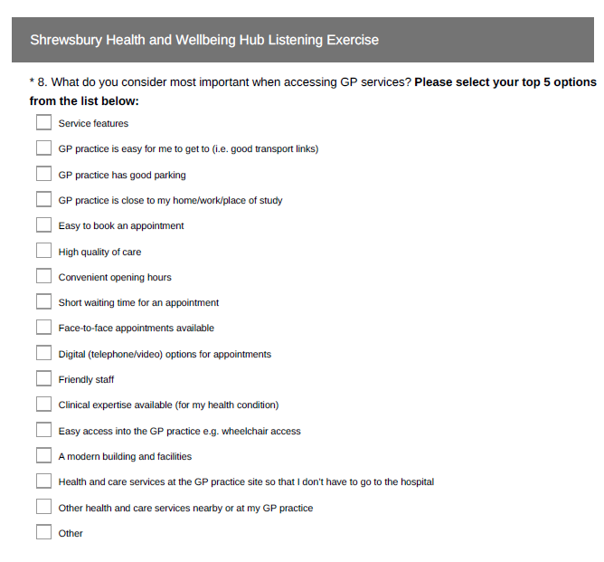
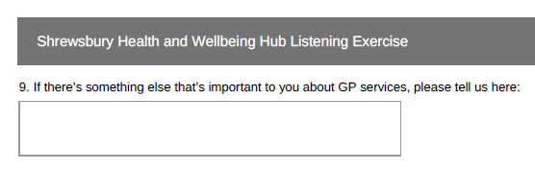
Shrewsbury Health and Wellbeing Hub Listening Exercise

Slide 25
Process to go from long list of scenarios to short list of options
Essential criteria defined by
Programme Team
Programme Team develop long list
Desirable criteria and weightings
defined by public and patients
Programme Team apply essential
criteria to develop medium list
Reference group apply desirable
criteria to medium list
to develop short list
Programme Team develop detailed short list analysis to develop preferred option(s)

Slide 26
Essential and desirable criteria
1st step:
essential criteria
2nd step:
desirable criteria
Finance:
A separate process, applied later in the development of scenarios.
All scenarios presented to NHS England must be financially viable.
Improving access and patient choice
Deliverability
Workforce
Affordability (high level)
Accessibility
Quality of care
Meets local needs
The reference group will weight the desirable criteria and then score the medium list using the desirable criteria
Applied by the programme team

Slide 27
Essential criteria and their domains
Improving access and patient choice
Deliverability
Affordability
Workforce
Criteria
Does the scenario protect against reduced patient choice and access?
Can the scenario meet demand now and in the future?
Is the scenario affordable and does it deliver value for money?
Do we have the workforce to deliver this option?
Is there a clear, clinical evidence base?
Does the scenario support recruitment and retention?
Domains
Is the scenario supported by stakeholders?

Slide 28
Desirable criteria and their domains
Range and
quality of care
Accessibility
Meeting local needs
Criteria
High quality of care (709)
Easy to book an appointment (719)
GP practice is close to my home / work / place of study (598)
Friendly staff (217)
Face-to-face appointments available (615)
GP practice is easy for me to get to (i.e. good transport links) (436)
Clinical expertise available (for my health condition) (174)
Short waiting time for an appointment (581)
GP practice has good parking (313)
Domains
Service features (25)
Convenient opening hours (244)
Health and care services at the GP practice site so that I don’t have to go to the hospital (172)
‘(xx)’ Frequency domain was selected during listening exercise survey.
Digital (telephone / video) options for appointments (93)
Other health and care services nearby or at my GP practice (27)
Easy access into the GP practice (e.g. wheelchair access) (32)

Slide 29
Discussion three | the options appraisal process
Do you understand the scenario development and evaluation process?
Is there anything else we need to include or change?
Do you understand the desirable criteria and their domains?

Slide 30
Next steps
Presenter: Dr Charlotte Hart

Slide 31
Next steps
A new reference group will be established to help us determine the weighting for each of the desirable criteria agreed within these focus groups
After the development of the possible scenarios, they will be evaluated by the desirable criteria – the scoring will be undertaken by the reference group
Our Equality Impact Assessment (EQIA) will be further developed as part of an Integrated Impact Assessment (IIA) to confirm the location, travel times and other details of the services proposed
A report of findings will be produced following this phase of engagement and feedback will be compiled. This will then feed into the work of the Programme Team to shape plans and will be published on the CCG/ICS website
A public consultation will be held in due course and is likely to run for 8 to 12 weeks between October and December 2022 (approximately).

Slide 32
Thank you for attending
You are now free to leave the meeting

