Slide 1

Cardiovascular Disease (CVD) High-level Recovery Strategy
2022/23 – 2023/24
January 2023
Tracey Jones, Deputy Director of Partnerships and Place
Alexandra Mace, Project Manager for Prevention and Health Inequalities

Slide 2


Introduction and Background 2
The National Picture 3
Local Intelligence 4 – 10
Local context
Size of the Prize - BP Optimisation
Atrial Fibrillation
Hypertension
Cholesterol
Heart Failure
Cardiology Outpatients
Patient Engagement 11
What are we doing well
Population feedback
Current Programmes of Work 12
Our Top Priorities 13 – 16
National Recovery Objectives
Local Priority Objectives
Comms. And Engagement
Governance 17
Summary and Next Steps 18
Appendices 19 – 26
Introduction and Background
Cardiovascular Disease (CVD) is the cause of a quarter of all deaths in the UK, and the largest cause of premature mortality in deprived areas. This is the single biggest area where the NHS can save lives over the next 10 years.
This document sets out the current context behind health outcomes related to CVD in STW and identifies key priorities to recover and improve those outcomes, in line with the ambitions set out in the NHS Long Term Plan:
STWs CVD Recovery Strategy further takes into account the high-impact objectives identified by the National CVD Prevention Recovery Plan 2023/24, to restore detection, monitoring and treatment of high-risk conditions. These are:
To prevent 150,000 heart attacks, strokes and dementia cases in the next 10 years.
To reduce the gap in avoidable CVD deaths between the most and least deprived areas for every year by 2029.
Monitoring and targeting unwarranted variation in care and outcomes.
System leadership to co-ordinate action to drive CVD recovery.
Supporting general practice to recover the management of key risk factors in atrial fibrillation, hypertension, and hypercholesteremia.
Accelerating making every contact count (MECC) interventions such as commissioning non-NHS providers, high street pharmacies and vaccination centres to undertake BP checks.
In addition to considering priorities for prevention, NHS England (NHSE) has asked healthcare systems to ensure their CVD Recovery Strategy references local priorities for Cardiac and Stroke improvement. Three priorities for each area have been requested. At the time of producing this initial plan, STW is in the early stages of initiating system-wide transformation programmes for Cardiology and Stroke. As such, high-level priorities have not yet been locally agreed for all areas. It is the intention that these will be developed over the coming weeks.

Slide 3
The National Picture
CVD affects around seven million people in the UK and is a significant cause of disability and death
CVD is responsible for one in four premature deaths in the UK and accounts for the largest gap in health life expectancy. Those in the most deprived 10% of the population are almost twice as likely to die as a result of CVD, than those in the least deprived 10% of the population
You are more at risk of having CVD if you have Atrial Fibrillation (AF), high blood pressure, or high cholesterol. These are known as the ‘high risk conditions’
You are more at risk of CVD if you have diabetes or a family history of heart disease, if you are a smoker, or are from a black, Asian, minority ethnic (BAME) background
There are significant health inequalities for people living with severe mental illness (SMI). Life expectancy is 15-20 years lower than the general population. People with SMI have a 53% higher risk of having CVD and 85% higher risk of death from CVD
Cardiovascular disease (CVD) is a general term for conditions affecting the heart or blood vessels. CVD includes all heart and circulatory diseases, including coronary heart disease, angina, heart attack, congenital heart disease, hypertension, stroke and vascular dementia.
https://www.england.nhs.uk/ourwork/clinical-policy/cvd/
Heart and Circulatory Diseases | Risk Factors
Heart Disease Heart Attack Heart Failure Heart Valve Disease Angina Arrhythmia Stroke/Transient ischaemic attack Peripheral Arterial Disease Aortic Disease | Atrial Fibrillation (an irregular heart beat) Hypertension (high blood pressure) Hypercholesterolemia (excess cholesterol) Hyperlipidemia (excess cholesterol) Diabetes Chronic Kidney Disease Obesity and excess weight Smoking tobacco Consuming too much alcohol

Slide 4








Local Context
Shropshire, Telford & Wrekin (STW) has an approximate population of 500,000 across two distinct geographical areas:
Telford & Wrekin – a predominantly urban area with significant areas of deprivation.
Shropshire – a predominantly rural area which has less deprivation (defined by the Core20) but a significant rural and older population (rurality has been locally considered as a PLUS factor).
Around 66,000 of those people are living with heart and circulatory diseases. These heart and circulatory diseases cause 110 deaths each month in Shropshire Telford and Wrekin. Around 81,000 people in Shropshire Telford and Wrekin have been diagnosed with high blood pressure and 13,000 with Atrial Fibrillation.
 | Telford & Wrekin | Shropshire
People living with heart and circulatory disease | 21,000 | 45,000
People diagnosed with increased blood pressure | 27,000 | 53,000
Stroke Survivors | 3,800 | 8,500
Atrial Fibrillation | 3,800 | 9,400
Heart Failure | 1,600 | 3,400
% of Adults with obesity or excess weight | 72% | 72%
% of Adults who do not meet physical activity recommendations | 34% | 31%
% of Adults who smoke | 15% | 14%
Locally, CVD mortality contributes 48.3% within Shropshire, and 51.3% within Telford & Wrekin to inequality in life expectancy, making it the largest contributing factor.
https://www.bhf.org.uk/what-we-do/our-research/heart-statistics/local-statistics

Slide 5
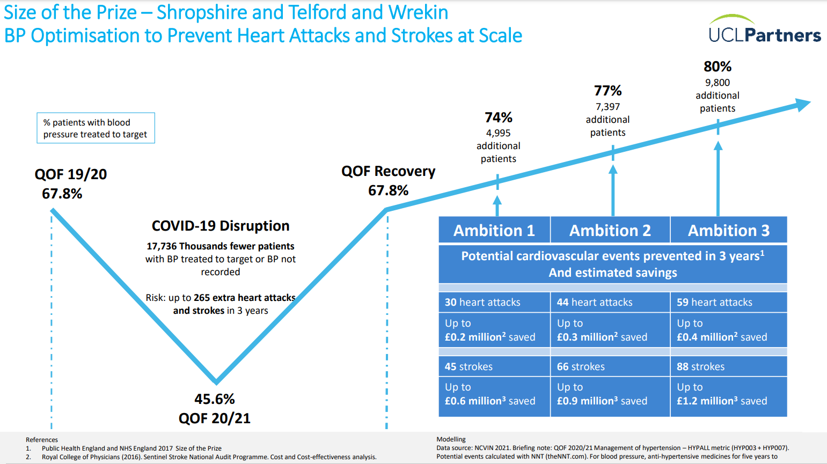
Local Context
The Covid-19 Pandemic had a significant impact on the availability of healthcare services. This impact was seen nationally and as a result, the number of patients with known high blood pressure being treated to (NICE specified) targets reduced.
UCLPartners undertook a data modelling exercise to quantify this impact, and the subsequent QOF recovery required to improve healthcare outcomes and save costs.
This graph shows us that if 77% of patients with high blood pressure are treated to target, this would prevent 44 heart attacks, 66 strokes and up to a combined 1.2 million GBP.
https://uclpartners.com/project/size-of-the-prize-for-preventing-heart-attacks-and-strokes-at-scale/

Slide 6
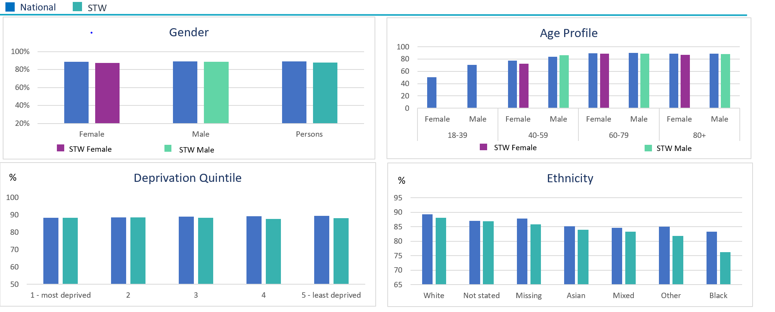
Local Data – Atrial Fibrillation
The Local Picture
The National Ambition
Atrial fibrillation (AF) is a heart rhythm disorder which can increase stroke risk. The condition can be asymptomatic but early identification and management can reduce the risk of stroke.
The diagnosed prevalence of AF in Shropshire was 2.9% against the estimated prevalence of 3.5%, and in T&W the prevalence was 1.9% against an estimate of 2.4% Estimates suggest there could be an additional 1875 people with undiagnosed AF in Shropshire and 925 in T&W. Cardiovascular Disease - OHID (phe.org.uk)
The national ambition is to increase the detection of AF to 85% of the expected number by 2029 – data for 2019/20 shows 82.6% detection (against an England value of 82.2%) with detection ranging across PCNs from 77.8% (Newport PCN) to 85.9% (Teldoc PCN) and across individual practices from 49.5% to 95.8%
The treatment target of 90% of high-risk patients with AF being anticoagulated by 2029, was achieved for 86.1% of the population in 2019/20 (lower than England at 87.3%).
These charts show differences in achievement across segments.
https://fingertips.phe.org.uk/static-reports/cardiovascular-disease-prevention/E54000011.pdf

Slide 7
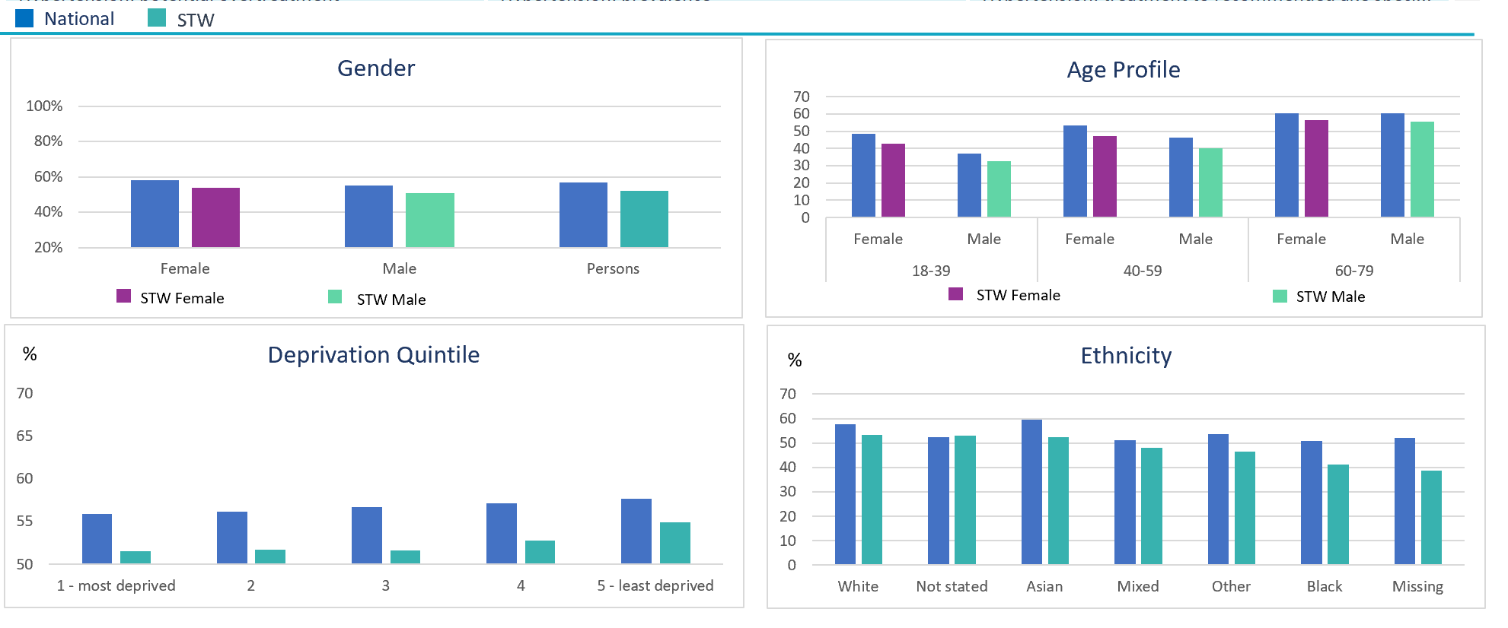
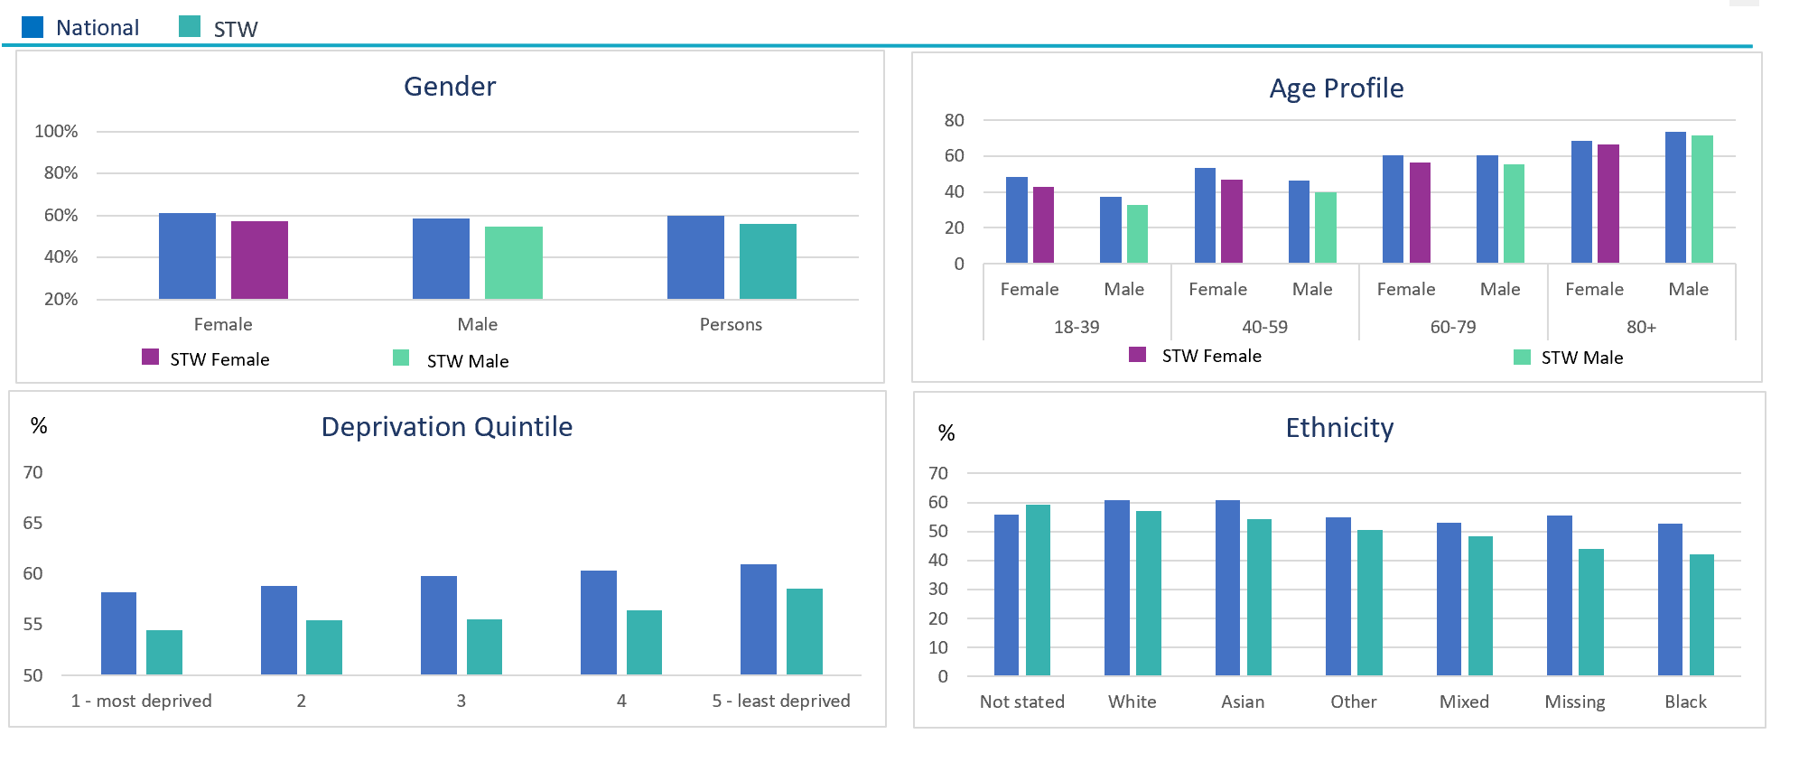
Local Data – Hypertension
The Local Picture
The National Ambition
Hypertension (also known as high blood pressure), can lead to serious and potentially life-threatening health conditions if left unchecked. This includes heart disease or failure, stroke, kidney disease and vascular dementia.
In 2019/20, 65.8% of the expected number were diagnosed across ST&W, with an estimated 16,330 undiagnosed; 11,370 undiagnosed in Shropshire and 4,960 undiagnosed in T&W. Across individual practices the range is from 56.2% of expected cases diagnosed up to 97.9%.
The 2023/24 planning guidance has set a target to increase the percentage of patients with hypertension treated to NICE guidance to 77% by March 2024. The latest data from CVD PREVENT (seen in the graph below) shows below for all ages groups.
Current achievement: Under 75s
Current achievement: All ages

Slide 8
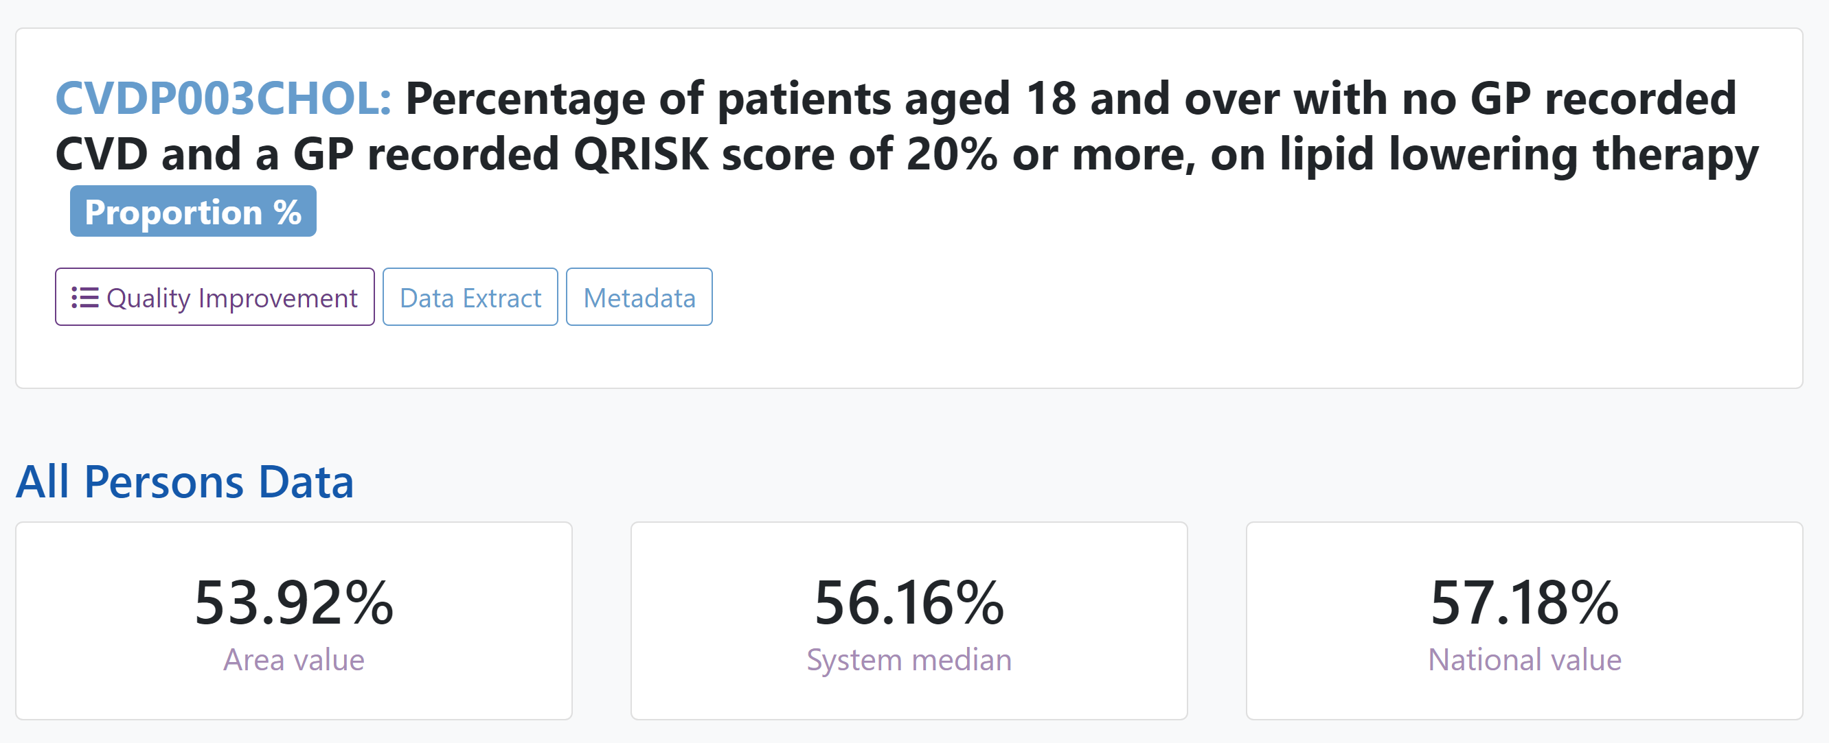
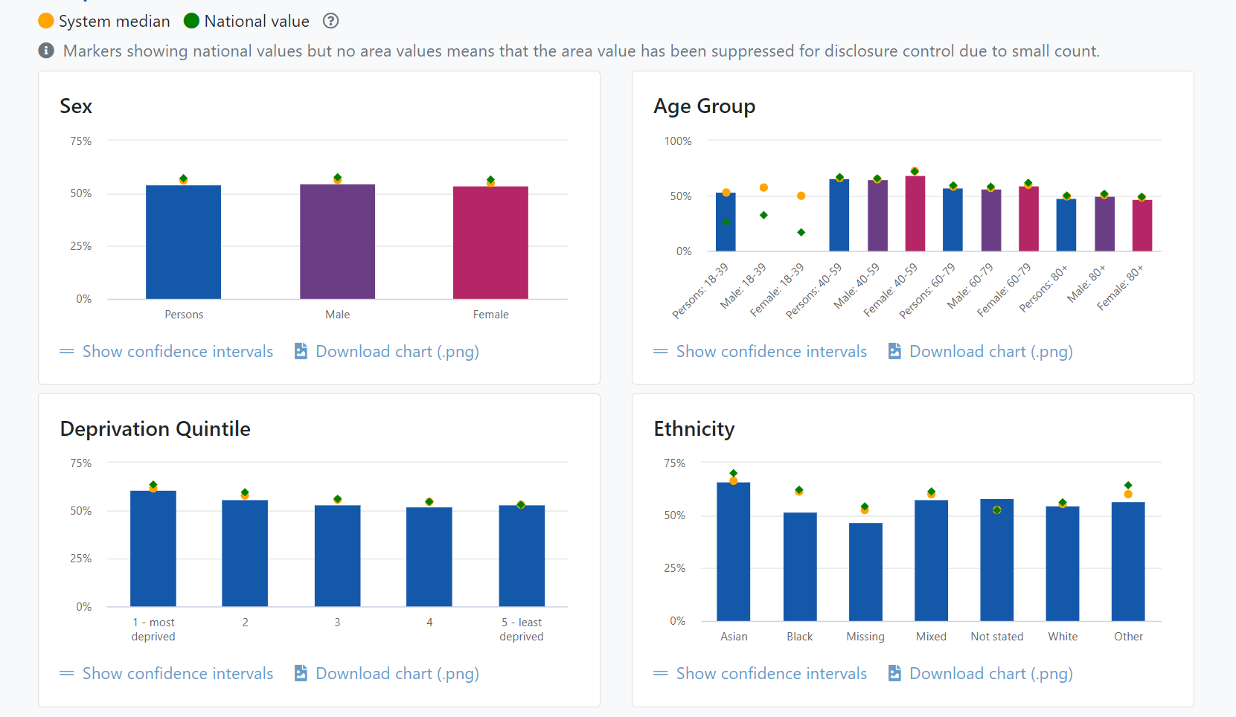
Local Data – High Cholesterol and Lipid Management
The Local Picture
The National Ambition
Cholesterol is produced by the liver to keep the cells in our bodies health. Excess cholesterol can increase the risk of heart attack or stroke.
Lipid lowering therapy with high-intensity statins is a clinically effective treatment option for the primary prevention of CVD (reducing the risk of first CVD events).
In the 2023/24 planning guidance there is a target to Increase the percentage of patients aged between 25 and 84 years with a CVD risk score greater than 20 percent on lipid lowering therapies to 60%.
This data provides a breakdown of STWs current achievement for lipid lowering therapies in primary prevention.
Based on the 2023/24 Operational and Planning Guidance, this is below target.
This chart show differences in achievement across segments.

Slide 9
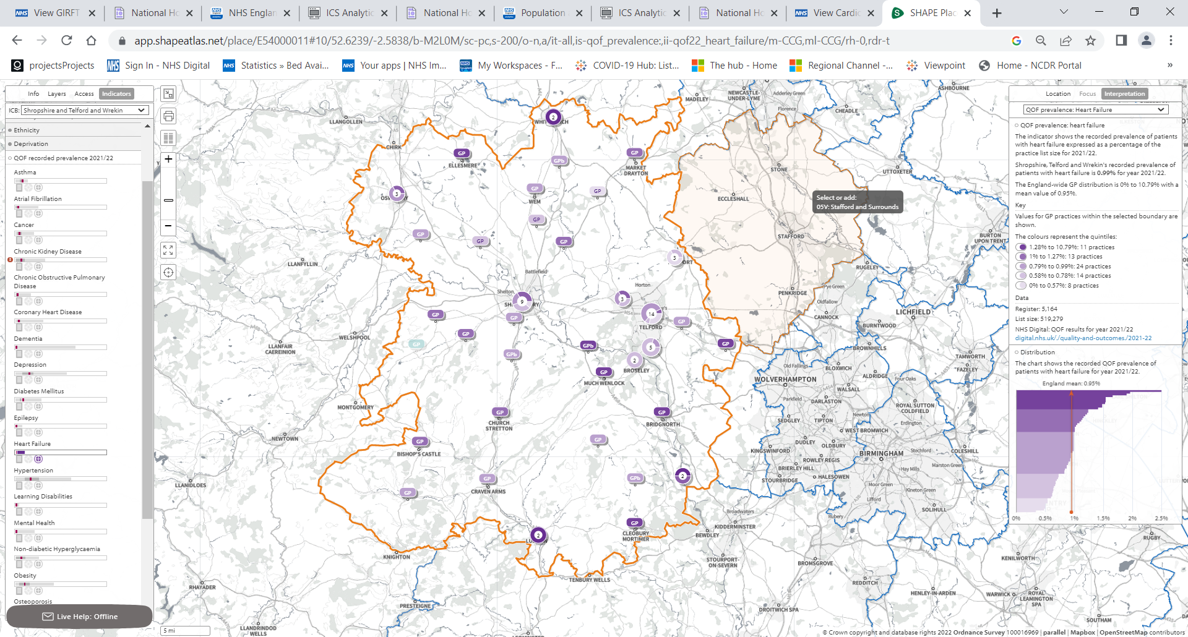
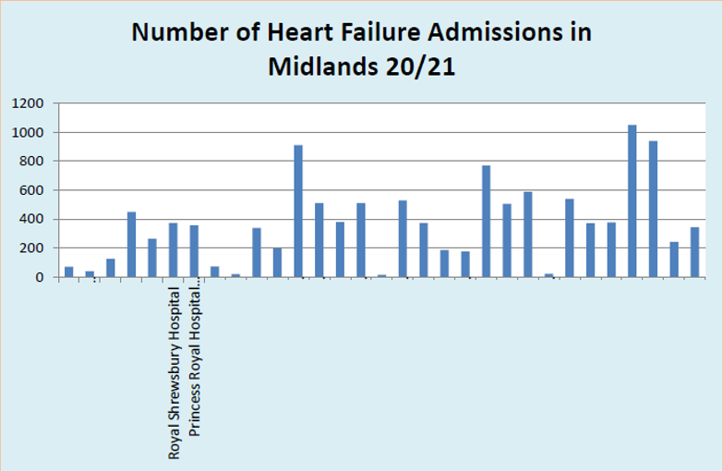
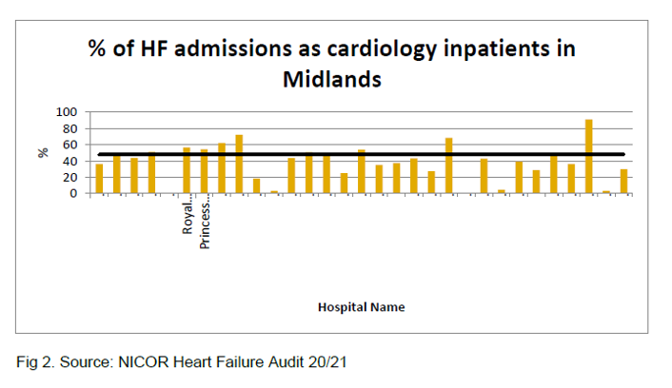
Local Data – Heart Failure
The Local Picture
The National Ambition
Heart failure is a condition where your heart can’t pump blood around your body as well as it should. It doesn’t mean your heart has stopped working but you may need support to help it work better.
Causes for heart failure include, but are not limited to heart attacks, high blood pressure, congenital heart conditions, heart valve disease and consuming too much alcohol.
In STW, almost half of our practice populations have heart failure prevalence higher than the national average.
Data highlights that one of the greatest concerns is the number of Heart Failure presentations in acute settings. Both local hospital sites see a higher percentage of Heart Failure admissions as cardiology inpatients compared to the regional average of 48%.
The NHS Long Term Plan specifically references that people with heart failure and heart valve disease will be better supported by multi-disciplinary teams as part of primary care networks.

Slide 10
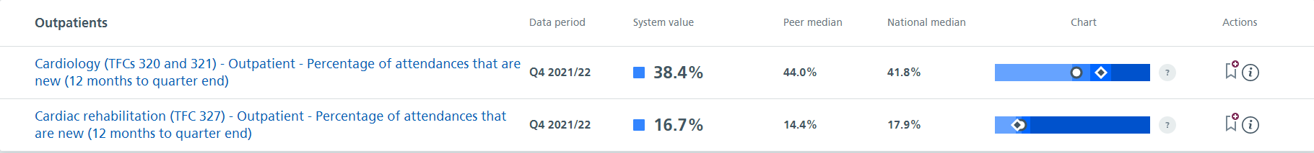
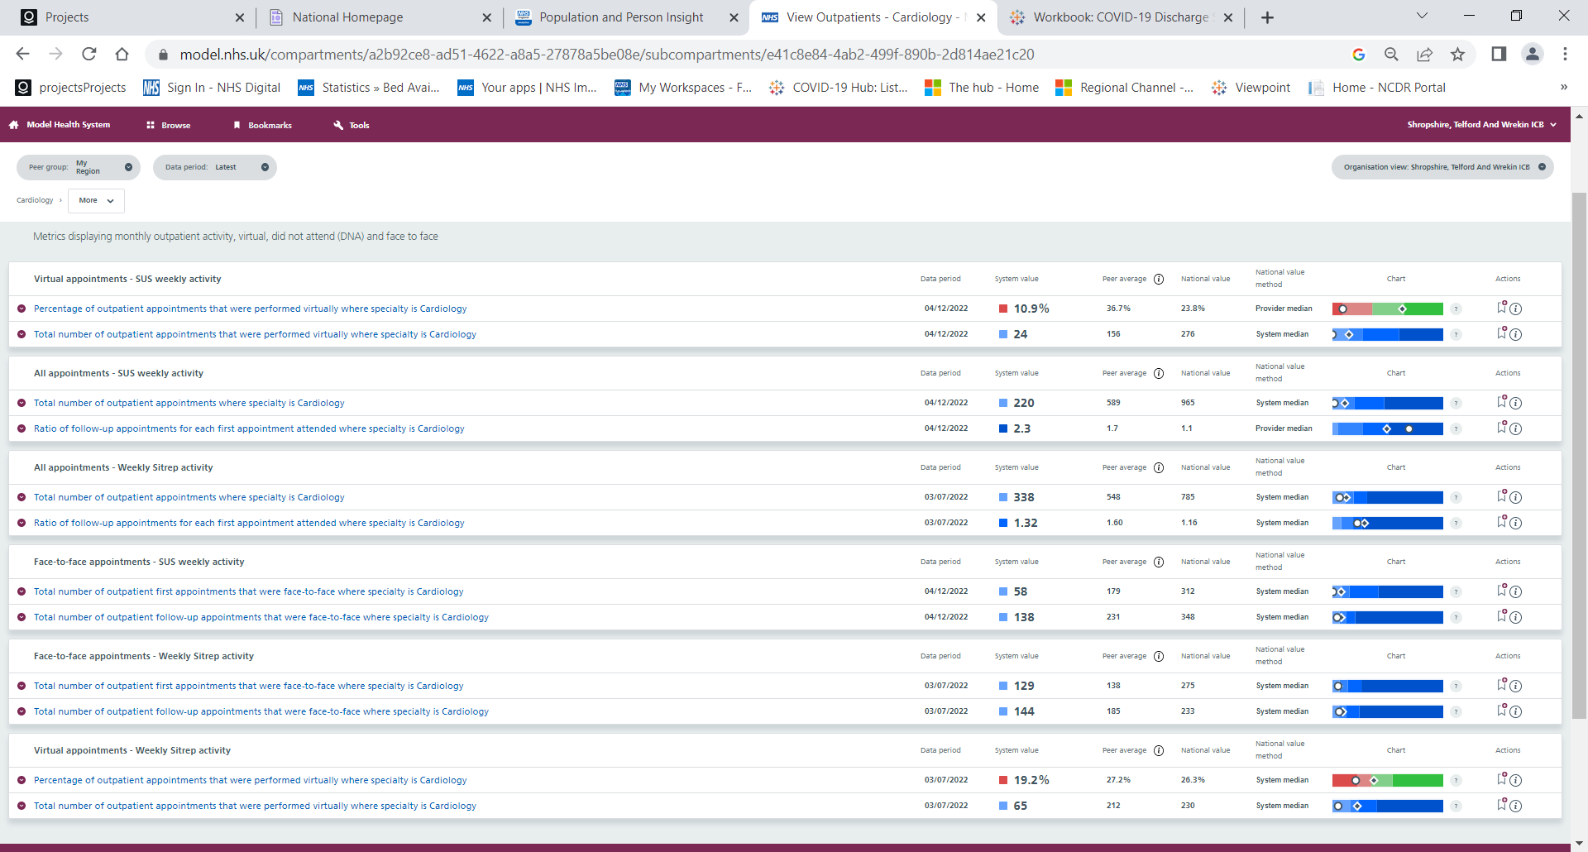
Local Data – Cardiology Outpatients
The Local Picture
The National Ambition
Cardiology is a broad specialty covering a number of different conditions and sub-specialties within hospital services.
Care provided by cardiology teams includes treating heart rhythms using interventions; the use of devices such as implantable cardioverter defibrillators (ICD) to treat abnormally fast or life-threatening heart rhythms; services to treat people with inherited cardiac conditions (ICCs) and adult congenital heart disease (ACHD) services.
National data currently shows that STW is an outlier for the number of Cardiology Outpatient appointments, both in total and those provided virtually. Local data shows that the % of total cardiology outpatient appointments in STW is lower than the regional and national %:
Shropshire, Telford & Wrekin 19.2%
Regional peers 27.2%
Nationally 26.3%
The 2023/24 Planning Guidance highlights the priority to deliver an appropriate reduction in outpatient follow-up (OPFU) in line with the national ambition to reduce OPFU activity by 25% against the 2019/20 baseline by March 2024.
There is a further commitment as part of the NHSE Outpatient Transformation Programme to give patients greater control and convenience in their appointments by offering telephone or video consultations, empowering people to book their own follow-up care, and working with GPs to avoid the need for an onward referral where possible.
Improvements to outpatient pathways will be made in line with CPIP, GIRFT and the NHSE Outpatient Transformation Programme.

Slide 11
Public Engagement and Feedback
What our patient’s say
As an ICS we understand the importance of developing our health and care services based on the views of our local population, alongside the evidence on population health. Our residents have said they wanted ‘A person-centred approach to our care,’ and this is central to all the work we are doing.
A recent Shropshire, Telford & Wrekin questionnaire highlighted measures which are most important to our patients. Top statements from all respondents included “Easy access to the information I need to help me make decisions about my health and care” and “Having the knowledge to help me to do what I can to prevent ill health”. Those who had long term conditions told us to focus on getting help and communications, impact of having more than one conditions, waiting times, access to ongoing care and support, transport and travel.
What’s going well?
Adopting the social movement ethos approach through the Core20PLUS5 Connectors Project has been effective in engaging with our harder-to-reach populations and most importantly, getting people talking.
NHS STW intend to use this methodology in other upcoming community outreach projects, such as the InHIP Hypertension Community Case-finding Project to ensure we focus resource on areas of most need and reduce health inequalities.
We asked our patients what we could do to help them be supported to live a healthier life, what services could do to provide them with better care and support and what would make it easier for them to take control of their own health and wellbeing.
People told us that a number of things are important and should be key priorities for our ICS:
Access and timely intervention e.g. local services that people know about, that are available when people need them (including 24 hour) and that they can get to easily, including services that can help people to live healthy lives such as affordable gyms and social groups.
Tackling isolation and loneliness e.g. Making sure socially isolated people know what support is available to them and how to access it, including homeless people and people who do not have a named GP or relationship with services.
Consistent and reliable information and education for all ages e.g. reducing confusion by giving clear and consistent information that can be trusted, including information about services such as available appointments and giving people a single point of contact to improve consistency, including appropriate signposting and offering information and advice (e.g. advice about medication).
Services working together, including information sharing and a flexible approach to working e.g. ensuring staff know what other services are out there and talking to each other, improved referral processes, social services and the NHS working together.
Building strong communities and investment in local people e.g. supporting and promoting local groups to enable and encourage people to get together, e.g. walking groups, dementia groups.

Slide 12
What are we currently doing?
Domain | Primary Prevention | Secondary Prevention
Enablers for Prevention | Developing a Population Health Management Approach in partnership with Local Authorities Embedding approaches in Health Inequalities in all streams of work. CVD focused training and education workshops focused on ABC case-finding and pathways and Heart Failure.
Population-wide Prevention | Healthy Lives/Lifestyles Services (a series of support services to encourage healthier living including smoking cessation, diet advice, exercise, and alcohol and drug-users services). Physical Health Checks within Local Authorities, including the Drugs and Alcohol Service. Health Literacy Access to advice and information
Tackling Health Inequalities | InHIP Project (Hypertension case-finding, specifically focused on Core20PLUS) Physical Health Checks for people with Severe Mental Illness (SMI) and Learning Disability (LD) | InHIP Project (Lipid Optimal Management)
National Prevention Programmes | Implementing Alcohol Care Teams within Acute settings. Increased referrals to Tier 2 weight management programmes and support. Provision of treatment and support to tobacco-dependant inpatients (incl. MH and maternity).
Primary Care | Social Prescribing (MECC approach) Atrial Fibrillation detection within Community Pharmacy and General Practice Hypertension checks in Community Pharmacy | Improved detection and management of Hypertensive patients Blood Pressure Monitoring @ Home Blood Pressure Monitoring Optimisation (with a key focus on most deprived areas)
Medicines Optimisation |  | Implementation of the Direct Oral Anticoagulants (DOACs) Framework
System-wide Transformation Programmes | Cardiology Transformation (aligned to CPIP and Outpatient Transformation) Stroke Improvement Programme Diabetes Transformation Dementia Services Vision | Cardiology Transformation Remote and virtual monitoring Stroke Improvement Programme
For the purpose of this plan, Primary and Secondary Prevention are defined as:
Primary Prevention – targeting individuals who are at risk of developing a medical condition and intervening to prevent onset.
Secondary Prevention – screening to identify diseases in the earliest stages and provide treatment to manage symptoms and prevent complications.
Additional detail for each programme has been included as an Appendix.

Slide 13
Moving Forward – Our Top Priorities
Cardiovascular
Disease Prevention
To embed and align system-wide initiatives which identify (ABC) at risk populations and support people to live a healthier lifestyle.
Cardiology Transformation
To reduce non-elective heart failure presentations in Acute settings, improve cardiac rehabilitation services and explore outpatient transformation.
Stroke Improvement
To ensure early and rapid diagnosis, best practice treatment and improve rehabilitation and life after stroke.
Clinical Priorities
Monitoring and targeting unwarranted variation
System leadership to co-ordinate action to drive CVD recovery
Supporting General Practice to recover the management of key risk factors (ABC)
Accelerating MECC interventions to undertake BP checks
Recovery Objectives
Data Intelligence
Accountability and Partnership
Diagnostics and Digital Innovation
Workforce, Training and Resources
Education and Access to Information
Enablers
Communications and Engagement

Slide 14
National CVD Recovery Objectives
Monitoring and targeting unwarranted variation in care and outcomes
Accelerating MECC interventions to undertake BP checks
System leadership to co-ordinate action to drive CVD recovery
Supporting General Practice to recover the management of key risk factors (ABC)
STW will continue to explore a variety of data sources (including CVDPREVENT, CVDACTION and local Heat Map data) to provide up to date, granular data, enabling a Population Health Management Approach in reducing health inequalities and to reduce unwarranted variation.
STW will continue to work with system partners to deliver case-finding and management interventions across all areas (Community Outreach, Primary Care and Secondary Care) to improve prevention and accelerate Make Every Contact Count (MECC) interventions.
Utilise learning from Core20PLUS-focused community outreach projects to better engage with and support our harder-to-reach populations.
Continue to explore and support innovation (including digital and diagnostics), such as Community Diagnostic Centres, Virtual Ward and Blood Pressure Monitoring @ Home, whilst embedding mitigations against digital exclusion).​
To ensure continued, strong accountability and partnership working across the ICS, with dedicated CVD leads at Executive, Clinical and PCN level.
To establish a strong governance framework for CVD Prevention, ensuring this aligns and coordinates with programmes of work targeting linked co-morbidities e.g. Diabetes, Stroke, Dementia and Cardiology Transformation.
Develop a comprehensive CVD Recovery Strategy based on further analysis of local data and in line with identified local priorities (incl. Cardiology, Stroke, Diabetes, Dementia, Chronic Kidney Disease and reducing health inequalities, including mental health).
Continue supporting PCNs and GPs to utilise available data sources and tools for risk-stratification, case-finding and management and to reduce unwarranted variation e.g. CVD Prevention Packs, CVDPREVENT.
Ensure maximum utilisation of BP@Home and the Blood Pressure Optimisation Programme.
Explore new opportunities for innovative management and intervention.
Provide additional training and development re Hypertension for Primary Care workforce.

Slide 15
Local Recovery Objectives
Population-wide Prevention
ABC Case-finding and Management
Reducing Health Inequalities
Develop a system-wide Population Health Management Approach which sets the direction for all service development and key areas of focus and outreach.
Continued offer of local Healthy Lives/Lifestyle services and community outreach programmes by Local Authorities (to support healthier living incl. physical activity, smoking cessation, diet advice, exercise, and alcohol and drug-users services).
Collaboratively embedding National programmes for Smoking, Alcohol and Weight Management, including the initiation of the NHS Low Calorie Diet Programme (November 23).
Continue supporting PCNs to implement the Network Contract DES and IIF requirements focused on case-finding and management of Hypertension, high Cholesterol and AF.
Implementation of the Direct Oral Anticoagulants (DOACs) Framework, specifically in relation to case-finding and management of AF.
InHIP Project (community Hypertension case-finding, specifically focused on Core20PLUS)
InHIP Project (Lipid Optimal Management) to support the detection and management of high cholesterol across both Primary and Secondary Care.
Embed successful approaches to tackling health inequalities across programmes e.g. Core Connectors, education and case-finding.
Exploring pathways and services for people who experience homelessness and drug-users.
Exploring innovative measures to increase uptake of Physical Health Checks for populations at most-risk, including people with Severe Mental Illness (SMI) and Learning Disabilities (LD).
Embedding Physical Health Checks for patients within Mental Health Services.
1st Line Prevention, Risk Identification and Management
Heart Failure
Cardiology Outpatients
Stroke and Co-morbidity Risk Factors
Agree priority actions within the STW Cardiology Transformation Programme – newly initiated (aligned to CPIP and GIRFT).
Increased focus on early and rapid diagnosis to reduce non-elective heart failure presentations.
Embed community service provision for heart failure patients, including diagnostics (echocardiography) and access to HF nurses.
Utilise and explore innovative measures to support patients, such as Virtual Ward and management of HF at home.
Agree priority actions within the STW Cardiology Transformation Programme (newly initiated) and Outpatient Transformation Programme.
Reduce cardiology outpatient appointments.
Undertake patient engagement to inform service transformation.
Explore innovative measures to support cardiology outpatients e.g. Patient Initiated Follow-up, Remote Monitoring/Virtual Ward.
Integrate and align system transformation work to provide a coordinated approach CVD Prevention across co-morbidities, including:
  Stroke Improvement – this programme is currently in development but will work closely with the North Midlands ISDN to implement the recommendations in the LTP and GIRFT.
  Implementation of the STW Dementia Vision Strategy, including advanced care plans, meaningful annual reviews and clear pathways to assessment services.
  Diabetes Transformation – this programme is currently in development.
  Chronic Kidney Disease and Mental Health Patients – programmes in development.
System-wide Transformation Programmes for Key Risk Factors and Outlier Areas

Slide 16
Comms. And Engagement Objectives
STW commits to raising awareness of CVD Prevention and will undertaken the following actions in line with CVD recovery:
Undertake a co-ordinated Comms. and Engagement exercise to understand the thoughts and needs of local people in relation to Outpatient, Cardiac and Stroke services. This will inform our developing Cardiology and Stroke Transformation Programmes.
Work with system partners to provide and maintain reliable and up-to-date resources on CVD, healthier living and where you can check your ABCs e.g. GPs, Community Pharmacies, Outreach Programmes.
Continue upskilling workforce (Primary Care and Volunteer Champions programmes) through focused training and development based on CVD Prevention (ABC, Heart Failure), Health Literacy and MECC.
Embed the Core20PLUS Connectors social movement ethos to empower our communities to raise awareness of CVD conditions, risks and preventative measures.
STW will align local comms. and campaigns with national campaigns to deliver key messaging with greater impact.

Slide 17
System Governance
Governance around CVD Prevention is a developing picture. The below structures represent an initial draft of how our current governance links together, however, this is yet to be fully determined as the ICS continues to develop and stabilise.
SRO: Gareth Robinson, Executive Director of Delivery and Transformation
CVD Lead: Tracey Jones, Director of MH, LD&A, CYP and ICB Lead for LTP and Health Inequalities
Clinical Lead: Dr Matthew Bird, GP and CVD Prevention Clinical Lead
Integrated Care Board
Health and Wellbeing Board
Local Transformation Programmes (Outpatient, Hospital and Local Care)
Integrated Delivery Committee
Population Health Management Board
Joint Commissioning Board
NHS Driven Prevention
Transformation Programmes
Nationally Driven Prevention
LA Driven Holistic Prevention
PCN Development
CVD Prevention Group
Cardiology Transformation Delivery Group
Stroke
Tobacco Dependency Steering Group
Alcohol Care Teams – Trust Led
Place-based Boards
CVD Operational Working Groups
Cardiology Clinical and Professional Advisory Group
Dementia
Obesity and Weight Management is discussed by respective stakeholders in service-related committees
Steering Groups for Healthy Lifestyle Improvements
Diabetes Transformation

Slide 18
Summary and Next Steps
Overall, STW has a mixed geography consisting of both significantly urban and rural areas. The system will embed a population-health management approach and explore new data sources to ensure we focus and design services in line with the greatest needs of the population.
STW has an increasing number of programmes which focus on supporting people to live healthier lives through behaviour change (ranging from CYP to Adults). Work will be undertaken to ensure these programmes are targeted towards people of most need, in line with the Core20PLUS.
Work will be undertaken to ensure case-finding and management of ABC is embedded as a system-wide, MECC approach and that people are aware of the local services on offer. This includes provision in General Practice, Secondary Care, Community Pharmacy and Community Outreach.
A number of transformation programmes focusing on key risk-factors and CVD conditions, including Heart Failure, Stroke and Diabetes, have been newly initiated and will develop over the next 12 months. In the coming months, programmes will set priorities based on local data and national guidance to improve local outcomes. These priorities will form part of STWs CVD Recovery Strategy for 2023/24 and further detail will be provided in the next iteration of this plan.
STW will align and coordinate these programmes through strong governance arrangements to ensure a system-wide, organised approach to CVD recovery.
Based on the high-level priorities outlined in this plan, STW will develop a comprehensive milestone plan by April 2023 which expands on the headline objectives and details the actions being taken to meet the ambitions of the Long Term Plan.

Slide 19
Appendices – Programme Details
Area | Target Condition or Risk | Project | Partners | Aims | Outcomes | Ref. NHS Target | Timelines
Population-wide Prevention | Smoking Alcohol Weight Hypertension Cholesterol | Healthy Lives, Shropshire | Local Authorities | Lifestyle management sessions Physical activity programmes Promoting healthy eating Promoting health literacy |  | Long Term Plan – Prevention and Healthier Living | Ongoing programme
Population-wide Prevention | Smoking Alcohol Weight Hypertension Cholesterol | Healthy Lifestyles, Telford & Wrekin | Local Authorities | Offer family-based behaviour change support through health chats, checks and personal plans via 80 weekly community clinics. | Improving in smoking quit rates. Improvement in NHSHC delivery levels Improved health outcomes. | Long Term Plan – Prevention and Healthier Living | Ongoing programme
Population-wide Prevention | Weight Physical Activity | Healthier Living (Programmes within Communities) Telford & Wrekin | Local Authorities | To use community-centred approaches to support communities in identifying their own solutions to better health outcomes. | Improved knowledge and understanding of health issues, outcomes and risk. More active communities. Community-led health initiatives. | Long Term Plan – Prevention and Healthier Living | Ongoing programme
Population-wide Prevention | Smoking Alcohol Weight | Local Authority Physical Health Checks Physical Health Checks specifically within Local Authority Drugs and Alcohol Services | Local Authorities General Practice PCNs | Collaborate with general practice and PCN’s to support the restoration of NHSHC delivery and increase levels where restoration has begun. Encourage and present opportunities to focus delivery within areas of inequalities, whilst also addressing areas of low uptake and increased CVD risk Further collaborate with partners on use of Point of Care and opportunities to connect systems To identify service users with, or at risk of CVD and other health conditions | Improvement in NHSHC delivery levels Improved health outcomes Develop understanding of system requirements and opportunities for POC | Long Term Plan – Prevention and Healthier Living | Ongoing programme
Population-wide Prevention | Smoking Alcohol Weight | Social Prescribing | Local Authorities PCNs | Identifies people at risk of obesity, smoking and alcohol working with them to make changes and people can access multiple groups and physical activity initiatives in the community. |  | Long Term Plan – Prevention and Healthier Living | Ongoing programme

Slide 20
Appendices – Programme Details
Area | Target Condition or Risk | Project | Partners | Aims | Outcomes | Ref. NHS Target | Timelines
Tackling Health Inequalities | Hypertension | InHIP – Targeted Hypertension (Community Blood Pressure Checks) | ICB Local Authorities Community & Voluntary | (i) To narrow the gap in the diagnosis of hypertension between the general population and those: Living in more deprived circumstances (Core20) Living in rural areas From ethnic minority groups (NB. There has not been direct quantification of this diagnosis gap) (ii)To increase population awareness of CVD risk factors and what action can be taken to reduce them (iii)To deliver MECC interventions to all community contacts (regardless of BP status) (iv)To recruit and train volunteers to undertake BP measurement and promote understanding of CVD risk among the target populations | (i)Increased detection of hypertension among the target groups. (ii)A narrowing in the diagnosis gap between the target groups and the general population (assumed gap) (iii)Increase in proportion of patients being appropriately treated for high blood pressure (iv)Reduction in heart attacks and strokes (longer term) (v)Increased community awareness of CVD risk factors and how to reduce them | Diagnosis: 80% of the expected number of people with hypertension are diagnosed by 2029 | Plan is expected to be delivered over a 12 month period
Tackling Health Inequalities | Atrial Fibrillation Hypertension Cholesterol | Physical Health Checks for people with Severe Mental Illness (SMI) as part of our Community Mental Health Transformation | ICB PCNs Local Authorities Community & Voluntary | To ensure 60% of those on SMI register received a SMI AHC To reduce health inequalities for SMI patients | An integrated physical health care pathway which includes primary and secondary services •Physical Health Pathway received Shropshire’s first Community Gold Award for Quality Improvement | 60% target for SMI physical health checks completed as part of the NHSE five year plan QOF. Long Term Plan. In PCN DES. STWLCS. Core 20+5 | May 2023
Tackling Health Inequalities | Atrial Fibrillation Hypertension Cholesterol | Physical Health Checks for people with Learning Disabilities (LD) | ICB PCNs Local Authorities Community & Voluntary Secondary Care | 75% of those aged 14+ on LD registers received a LDAHC. Grow LD registers to ensure people who are eligible are on register. | Yes working to reach target | QOF, Long Term Plan, In PCN DES & IIF.

Slide 21
Appendices – Programme Details
Area | Target Condition or Risk | Project | Partners | Aims | Outcomes | Ref. NHS Target | Timelines
Tackling Health Inequalities | Cholesterol/ Lipids | InHIP – Targeted Lipid Management within Secondary Care | Secondary Care Primary Care | To provide focused interventions to improve secondary prevention lipid management in line with the national lipid management guideline. Address local health inequalities and inequity by selecting those Practices most in need and individualising the support approach. Improve lipid management and provide patients with a sustainable, flexible, high-quality, person-centred specialist service offering that is convenient to them. Specialists will support primary care colleagues through mentorship and education and in turn the work in primary care will reduce the pressure on acute services. Through this project, long-term system wide working relationships will be built primary care teams upskilled continue good lipid management and positive outcomes for our population. | Reduction in LDL-cholesterol levels for patients with an existing diagnosis of coronary artery disease. Individualised cholesterol management plan for each patient addressing barriers and concerns. Improvement in compliance with national recommendations for lipid lowering therapy as demonstrated in UCL-partners and CVDprevent data. (Increase in high intensity statins, reduction in non-recommended agents) Long term: Reduction in hospital re-admission rates for cardiovascular events Reduction in consultant clinic time for medicines optimisation | Improving and increasing early detection and treatment of CVD to help patients live longer, healthier lives. We will work towards people routinely knowing their ‘ABC’ numbers – (AF, blood pressure and cholesterol) Increase referral and uptake of cardiac rehabilitation (Aim attendance by 85% of eligible people by 2028) Identify patients with Familial Hypercholesterolaemia Network Contract DES 9.6 Cardiovascular disease prevention and diagnosis (addressing cholesterol in the context of CVD risk) 9.7 Tackling neighbourhood inequalities (identify a population experiencing inequality in health provision and/or outcomes, agree with the commissioner an approach to engagement and tackling the unmet needs of the population) | Present – November 2023 Feb 2023 - Agree service models and funding arrangements for primary and secondary care November 2023 – Collate and review preliminary data from the cardiac rehabilitation clinic to support the business case to the Cardiology division/ ICB to continue the Pharmacist work in both Primary and Secondary care going forward.

Slide 22
Appendices – Programme Details
Area | Target Condition or Risk | Project | Partners | Aims | Outcomes | Ref. NHS Target | Timelines
National Prevention Programme | Smoking | Tobacco Dependency Treatment Programme | ICB SaTH MPFT | Delivery of tobacco dependence treatment will: have a positive impact on current treatment of patients reduce risks to developing foetuses and new-borns in pregnant women close health inequality gaps – smoking is most prevalent in deprived communities reduce demand on NHS services | Number (%) smokers successfully quit at 4 and 12 weeks by service Smoking Prevalence 18+ Smoking at time of delivery (SATOD) Smoking Attributable Mortality Smoking Attributable Hospital Admissions Number (%) smokers successfully quit at 4 and 12 weeks | Key component of the NHS LTP which commits to provide NHS funded tobacco dependency treatment to all inpatients and pregnant women who smoke by the end of 2023/24. | 2022/23 – acute inpatient, maternity and mental health inpatient 2023/24 – community hospitals, RJAH, staff offer community mental health
National Prevention Programme | Obesity | NHS Digital Weight Management Programme | ICB Primary Care | Support people to manage their own weight Improve quality of life Improve longer term health conditions Benefit the NHS by preventing future diseases To make weight management services accessible to more people, by providing them digitally | Reduction in those with a BMI of 30+ (>27.5 for ethnic minorities) Reduction / reversal of those with type 2 diabetes diagnoses Reduction / reversal of those with hypertension diagnoses Reduction in hospital admissions for obesity related conditions | Supports the NHS LTP on obesity, focusing on weight management to support people living with obesity who also have a diagnosis of diabetes, hypertension or both. | I believe this is reviewed annually by NHSE but no detail yet received for a 2023/24 programme.
National Prevention Programme | Alcohol Consumption | Alcohol Care Teams | ICB SaTH | reduce the length of stay for inpatients by improving the management of withdrawal provide appropriate, timely, meaningful education and support for those attending or being admitted with alcohol-related problems provide psychosocial interventions to support dependent drinkers to sustain abstinence following discharge improve compliance with the trust’s alcohol withdrawal guidelines educate staff on alcohol use disorder and its management improve information sharing between services (such as secondary care, primary care and community services) improve data collection and opportunities for analysis |  | Key component of the NHS LTP which commits to improving the quality of alcohol-related care, by establishing specialist Alcohol Care Teams (ACTs) in acute hospitals. | Planned recruitment of ACT Lead Post (12 months fixed term) commencing February 2023. Planned additional recruitment of 2 x Alcohol Support Workers.
National Prevention Programme | Diabetes | National Diabetes Prevention Programme | ICB Primary Care | Improve outcomes for patients living with Diabetes in ST&W. | Improved treatment targets for blood pressure, cholesterol and HbA1c. Reduction in long term complications including amputation. Reduction in admissions to hospital for severe hypoglycaemia and diabetic ketoacidosis. |  | Ongoing

Slide 23
Appendices – Programme Details
Area | Target Condition or Risk | Project | Partners | Aims | Outcomes | Ref. NHS Target | Timelines
Primary Care | Hypertension AF Cholesterol | PCN Support Programme | ICB Primary Care Team PCNs | To provide a structured support package to PCN’s to achieve DES requirements, including: CVD Packs Risk Stratification tools Training and Education workshops for ABC and Heart Failure PCN’s in the driving seat of CVD management | DES requirements met CVD leadership achieved at PCN level Consistent high quality approach across STW | Network Contract DES | Implemented July 2022
Primary Care | Hypertension AF Cholesterol | Data and Intel Monitoring | ICB Primary Care Team PCNs | To gain appropriate data and intel on prevalence, target populations & individuals & measure activity/ performance. Exploration of CVDPREVENT Provision of local Heat Maps. | Greater clarity on how to most effectively channel activity and measure impact and outcomes Adds CVD layer to key intel document to aid targeting of activity/ resources More capable workforce Greater delivery capacity | Network Contract DES | March 2023.
Primary Care | Hypertension AF Cholesterol | Training and Development | ICB Primary Care Team ICB Training Hub PCNs | To upskill our workforce around CVD to maximise impact of the programme. Training and Education workshops for ABC and Heart Failure | More capable workforce Greater delivery capacity | Network Contract DES | Training offered to all practices via STW training hub Hypertension 11th May 22 & 15th June 22 Heart Failure- 25th May 21st June
Primary Care | Hypertension | Blood Pressure Monitoring @ Home | ICB Primary Care Team PCNs | TO enable practices to deploy BPM’s to most vulnerable patients in order to enable them to monitor their BP at home | Better LTC management Reduced unplanned attendances | Network Contract DES Long Term Plan | Provision of BPM’s based on population Ongoing
Primary Care | Hypertension High Cholesterol | CVD Prevention PCN DES Implementation | Primary Care ICB Local Authorities | Improve the diagnosis and management of patients with hypertension. through: Reviewing patient records, to identify patients who have had a previous high BP but have no diagnosis . Ensure all patients with hypertension are treated in line in with NICE guideline NG 136. Increase opportunistic blood pressure testing where patients do not have a recently recorded reading (including community case-finding and promoting take-up of pharmacy case-finding service). | Improved detection of hypertension (ie at practice and PCN level reduce the gap in the estimated (expected) vs actual prevalence of hypertension) and improved management of hypertension (in line with NICE guidance). | Diagnosis: 80% of the expected number of people with hypertension are diagnosed by 2029 Treatment: 80% of the total number of people diagnosed with hypertension are treated to target as per NICE guidelines by 2029 | Not clearly specified but had assumed we needed to get processes and delivery established in year 1 for hypertension (by April 2023) and then move on to case-finding/treating AF and Cholesterol, but likely that insufficient progress has been made due to increasing pressure and limited local capacity and resource in 2022/23.

Slide 24
Appendices – Programme Details
Area | Target Condition or Risk | Project | Partners | Aims | Outcomes | Ref. NHS Target | Timelines
Medicines Optimisation | Atrial Fibrillation | National DOAC Framework Implementation | Secondary Care Primary Care PCNs | Identification of diagnosed AF patients who are not anticoagulated and offer DOAC 1st line/VKA where DOAC contra-indicated. | Increase % of appropriate patients with AF prescribed an anticoagulant in-line with NICE 196 Reduction in amount of monitoring required from use of DOAC, freeing up capacity in primary and secondary care Reduce the number of appropriate people with AF who are untreated with an anticoagulant therefore reducing the risk in the number of AF related strokes. Reduction in hospital admissions/re-admissions because of AF related stroke Reduction in health burden as a result of AF related stroke | IIF CVD-05 NHS Long-term plan (CVD disease prevention) | Initially by end Mar 23, this may be extended. Secondary care supporting with Edoxaban initiation/recommendation first line for AF. Primary Care reviewing patients and changing therapy to first line formulary alternative in AF where appropriate. There may be some input from community pharmacy with reviewing patients recently discharged or newly commenced on anticoagulation via the Discharge Medicines Service or New medicines service.
Medicines Optimisation | Atrial Fibrillation | National DOAC Framework Implementation | Secondary Care Primary Care PCNs | New initiations of a DOAC to be edoxaban where appropriate. Identification of diagnosed AF patients prescribed a DOAC which is not edoxaban for consideration to prescribe edoxaban if appropriate. | Increased use of edoxaban as a proportion of all DOACs for AF indication. Provide cost efficiencies for increased use of DOACs | IIF CVD-06
Medicines Optimisation | Atrial Fibrillation | National DOAC Framework Implementation | Secondary Care Primary Care PCNs | Identification of diagnosed AF patients prescribed a DOAC where dose is not optimised or have a co-prescription with aspirin and/or antiplatelet | Reduction in number of patients sub optimally anticoagulated/not on optimal dose. Reduction in serious adverse events as a result of potential overdose/ contraindication | IIF SMR-03
Medicines Optimisation | Atrial Fibrillation | National DOAC Framework Implementation | Secondary Care Primary Care PCNs | Ensure equitable access to DOAC therapy across all practices | Reduction of inter-practice variability. | NHS Long-term plan (CVD disease prevention)

Slide 25
Appendices – Programme Details
Area | Target Condition or Risk | Project | Partners | Aims | Outcomes | Ref. NHS Target | Timelines
System Transformation | Heart Failure Heart Valve Disease | Cardiology Transformation Programme | ICB Secondary Care Primary Care PCNs | Aims •Reduce Cardiovascular disease related mortality •Ensure high quality outcomes and safety of care across the pathway •Provide person-centred responsive services, offering better experiences of care, with more equitable access •Improve and refine pathways and processes to provide clinically excellent cardiology services with restored services and reduced waits •Improve integration of cardiology pathways across primary, community and secondary care to function collectively as one service with one common aim. •Improved focus on preventative and proactive care •Develop services that are clinically, financially and environmentally sustainable with reduced duplication and improved resource efficiency. •Ensure value for money of commissioned services through provider collaboration. •Providing increased support, development and accountability for the cardiology workforce •Improve the flow, quality and use of information in order to optimise decision making; both operationally and strategically. •Ensure the involvement and engagement of patients and public in the design and development of cardiology services •Develop and encourage innovation in the delivery of cardiology services •Increase the ability of the Integrated Care System in Shropshire Telford and Wrekin to look after a growing and ageing population •Support the CVD prevention agenda | •Reduced CVD mortality •Improved focus on preventative and proactive care •Better quality and safety of care across the pathway •Restored services and reduced waits (Reduction in post COVID waiting list backlog) •More equitable access •Sustainable costs •Improved patient experience of care and outcomes •Improved clinical outcomes through timely access to advice and services •Improved experience for staff in services •Reduction in face to face appointments & consultations •Reduction in overdue follow ups •Reduction in appointment DNA’s •Increase in Nurse led/AHP clinics •Increase in uptake of advice & guidance (which results in preventing physical appointments) •Introduction/increase of patient initiated follow up where clinically appropriate •Increase in uptake of remote and virtual monitoring •Operational efficiencies generated through redesign would release capacity from outpatients, and be available in the interim to accommodate and address the waiting list backlog but would eventually become an efficiency longer term •Better use of patient’s time •Financial savings to patients and the system (time, travel and resource efficiencies) •Better use of clinical time and physical space •A fit for purpose modern service that meetings patients’ expectations ready for future technical developments •Reducing air pollution, environmental harm and avoidable deaths through reduced need for patient travel and subsequent reduction on CO² emissions | NHS Long term plan-Cardiovascular disease with particular reference to: 3.70. People with heart failure and heart valve disease will be better supported by multi-disciplinary teams as part of primary care networks. 3.72. Cardiac rehabilitation is an intervention recommended by NICE which can save lives, improve quality of life and reduce hospital readmissions NHSE Outpatient Recovery and Transformation Programme Transforming outpatients services for patients through by offering telephone or video consultations, empowering people to book their own follow-up care, and working with GPs to avoid the need for an onward referral where possible. The Cardiac Pathways Improvement Programme (CPIP) brings together NHSE&I collective priorities set out in the Long Term Plan, and by GIRFT, Specialised Commissioning, and the National Outpatient Transformation Programme. The CPIP team works in alignment with existing national programmes, focusing on key goals and priorities, and supports Cardiac Networks and Systems to deliver a comprehensive approach to whole pathway improvement and transformation. | The programme will span a 2 year period from Nov 2022 to ensure alignment between the recommissioning of new models of Cardiology, and current contract end dates.

Slide 26
Appendices – Programme Details
Area | Target Condition or Risk | Project | Partners | Aims | Outcomes | Ref. NHS Target | Timelines
System Transformation | Stroke | Stroke Improvement Programme | ICB Secondary Care Primary Care PCNs | The overarching aim of the Stroke Improvement Programme is to bring key stakeholders together to collaboratively review, develop, and improve the pathways spanning Primary, Community and Secondary Care for individuals in STW who are at risk of a stroke or have had a stroke and are recovering. The group will work together with the North Midlands Integrated Stroke Delivery Network (ISDN) to drive forwards the implementation of the recommendations in the NHS Long Term Plan and the Getting It Right First Time (GIRFT) Stroke National Specialty Report. Ensuring the ICS has a coordinated approach to improvement work relating to Stroke Ensuring that any improvements which are agreed for implementation are clinically robust and offer high quality care Considering the clinical, financial and system-wide operational impact of improvements and any further work required Monitoring and improving KPI’s related to Stroke | Reduce the incidence of stroke in STW Reduce the level of disability due to stroke Reduce variation in stroke services across STW | NHS Long Term Plan Stroke Care with particular reference to: 3.75 ISDNs will support STPs and ICSs to reconfigure stroke services into specialist centres, improve the use of thrombolysis and further roll out mechanical thrombectomy. 3.76. The NHS will work with Health Education England to modernise the stroke workforce 3.77. Implementation and further development of higher intensity care models for stroke rehabilitation National Stroke Service Model (May 2021) National Service Model for an Integrated Community Stroke Service (Feb 2022) | 2 years initially then review
System Transformation | Dementia | Implementation of the new co-produced STW Dementia Vision |  | People living with dementia and their unpaid carers are able to live the lives they choose that enhances and preserves their wellbeing. This specifically includes advanced care plans, meaningful annual reviews and clear pathways to assessment services. | Dementia friendly GP Practices and communities Timely assessments Improved diagnosis and assessment pathways Meaningful annual reviews Early help and support Respite for unpaid carers Reduced admission to a mental health bed for those with dementia Reduction in families reaching crisis point Improved carers support Better peer support across the county More personalised care and support Increase in dementia diagnosis rates | Dementia Diagnosis rates | 3-year programme

