Slide 1
Patient Journey Through Frailty
Lead Consultant - Dr Oja Pathak
Matron - Claire Davies
Cente Manager – Angela Raynor

Slide 2
Patient 1 Story

Slide 3
Background
85 year old female
Lives in a care home
Medical history of: Dementia, Anxiety & Agoraphobia
Multiple medications
English is not her first language (although is fluent when well)
Does not do well outside of her familiar environment

Slide 4
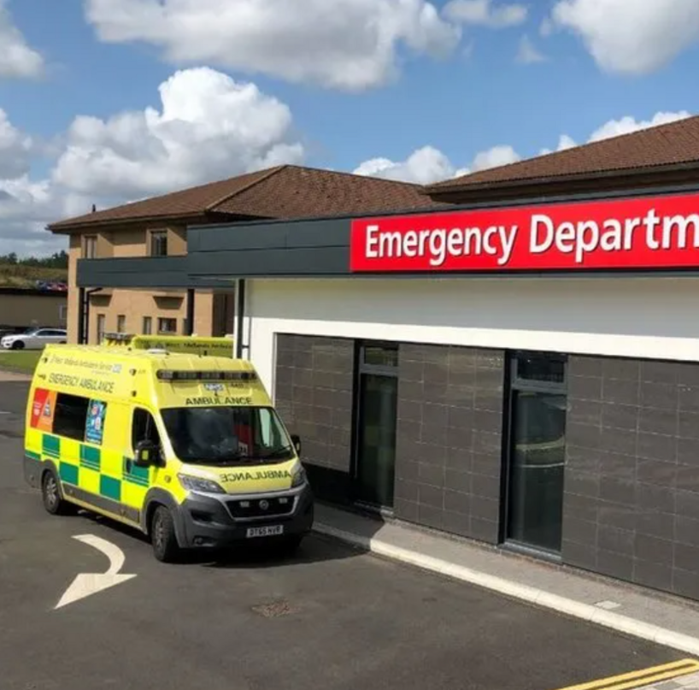
Emergency Department
Patient was sent to ED following an episode of low blood pressure in her care home.
She had been poorly throughout the week with a viral illness that caused some episodes of vomiting
She was isolated in a side room for 24 hours in ED
She was very upset as doesn’t like being alone (especially in unfamiliar spaces)
She was calling for help frequently due to her anxiety
Nursed in bed due to being a high falls risk
IV fluids in progress
Normal medications not given
Communication was challenging as patient 1 was distressed due to people, noise etc.

Slide 5
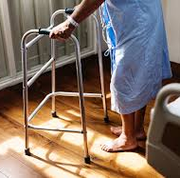
Frailty intervention
Screened by the FAU team
Changed into her own clothes
Walked to the toilet
Transferred to FAU
Sat in chair space
Listened to the radio in a calmer environment
FAU staff were always visible which helped her anxiety
Responsive to patient 1’s needs
Supported her in taking her medication

Slide 6
What Happened Next….
Was able to sit to stand with her frame within 1 hour of arrival in FAU
Eating and drinking without vomiting
Returned to care home on the same day
Referred to virtual ward to monitor low blood pressure

Slide 7
Possible Outcomes without FAU
Had she remained in ED:
Possibly remained in bed and deconditioned
Missed doses of her medication that manage her cognitive conditions
Behaviour may have escalated to which would lead to a prolonged admission
Reduced ability to engage with the MDT to participate in assessments
Reduced oral intake as she ate/drank better in the chair
Medicalised for onward IV hydration

Slide 8
Thank You

Slide 9
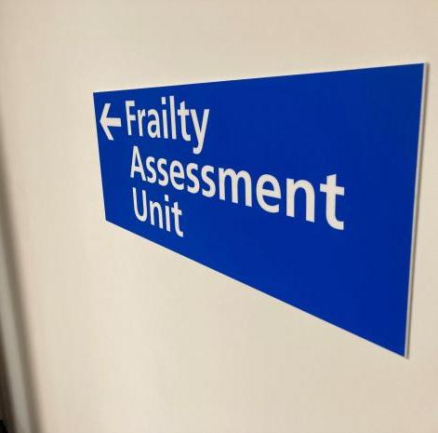
Patient 2 Story

Slide 10
Background
89 year old female
From her own home
Cognitively intact
Pain in right knee but able to weight bear
Pain worsened over 7 days so presented to ED
Ankle fracture confirmed
Provided with a walking boot and fracture clinic appointment
Discharged home at patient 2’s request

Slide 11
Fracture Clinic
Stated that she had been struggling at home
Advised non-weight bearing and placed in a plaster
Referred to frailty team for assessment
Frailty pulled direct to FAU to avoid a crowed ED

Slide 12
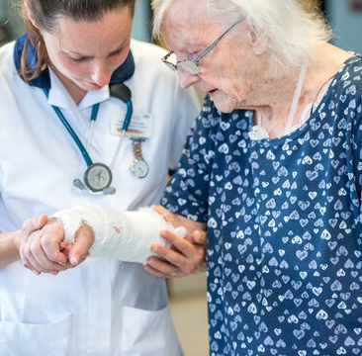
Frailty Assessment Unit
ACP, Consultant and Therapy input within 2 hours of arrival to FAU
Comprehensive Geriatric Assessment complete by the FAU MDT
Plan to discharge to a community bed when available
Care discussed with patient and next of kin with updates throughout the day
Staff visible in the department to support with care needs

Slide 13
Possible Outcomes without FAU
Prior to FAU
Patient 2 would have moved from fracture clinic to ED to await clerking by the acute medical team
Prolonged stay in ED due to bed pressures
Delay in referral to specialty for input
Placed in the hospital based on bed availability (any medical bed)
Onward delays to discharge from lack of admission avoidance pathways in other areas

Slide 14
Thank You

Slide 15
Patient 3 Story

Slide 16
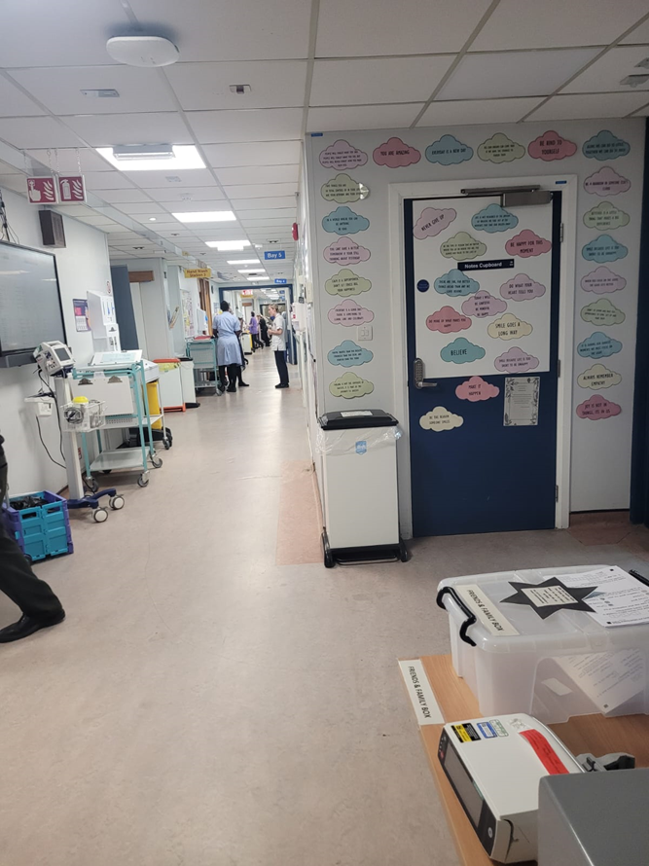
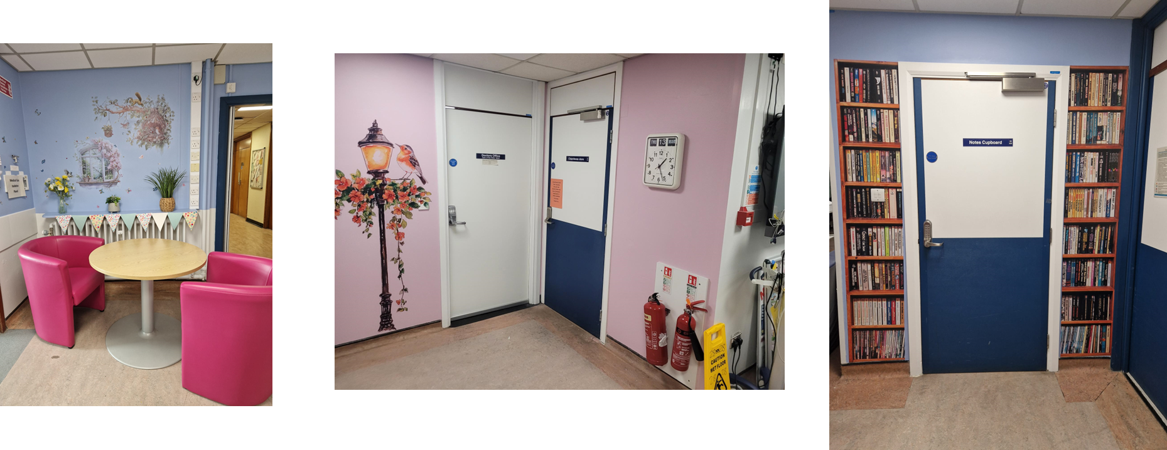
Ward Experience
Patient 3 has a known dementia and becomes increasingly confused in unfamiliar environments
EPS care was required due to increasing confusion and purposeful walking
Didn’t understand where she was or why she was there
-------------------------------------------------------------------------------
Patient 3 was taken to the ‘donate to motivate wardrobe to ‘choose her outfit’ for the day
Walked to the ‘café’ for a posh cup of coffee (in a China cup)
Read the available magazines/books
Reported as having a lovely day out
Confusion improved as purpose introduced into her day

Slide 17
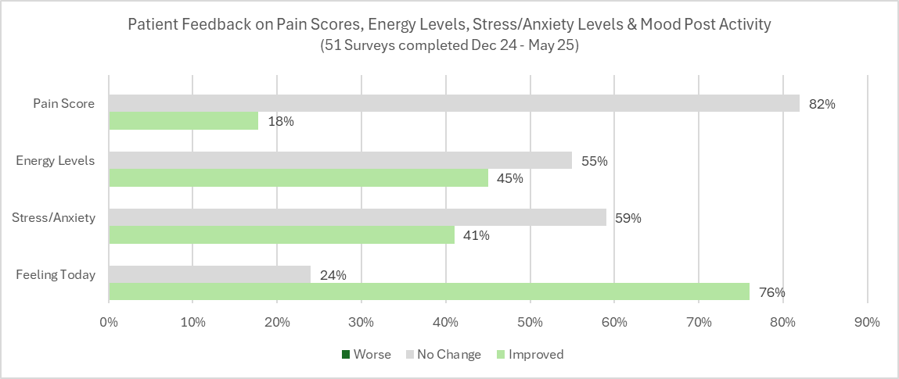
Benefits of Frailty
Above trust average for patients getting up and dressed in the morning. Both wards are currently at 60%
A bay a day activities to help keep patients active on ward 9
Introduction of therapeutic area on ward 28
Specialist rise and reclined chairs sought via charitable funds for those that struggle to get up
76% patients reported feeling better with 45% patients reporting increased energy levels while in hospital
Cases of HAI has improved over the past year
EPS requirement has reduced over the last 8 months
77% patients going home on PW0
Patient reported that the therapeutic area ‘took her mind off the negative and upsetting thoughts in her head’ and that it was a ‘good distraction’

Slide 18
Thank You Any Questions?

