Slide 1
NHS Pharmacy First Midlands Toolkit
Notes:
Standard title slide

Slide 2
Contents
 | Item
1. | Overview of Pharmacy First Service – Presentation aimed at GP Practices and Primary Care Networks
2. | NHS Pharmacy First Service Specification, Clinical Pathways and Patient Group Directions (PGD)
3. | Pharmacy First – Updating patient records after pharmacy consultation EMIS Web TPP SystemOne
4. | Patient Facing Promotional Materials
5. | Find a Pharmacy – Services offered by community pharmacy
6. | Community Pharmacy - Blood Pressure Checks Service
7. | Community Pharmacy - Oral Contraception Service
8. | Message Templates for Email/ SMS

Slide 3
Community pharmacy advanced service specification: NHS Pharmacy First Service
NHS Pharmacy First Service Specification
NHS Pharmacy First – Clinical Pathways
Pharmacy First - Clinical Pathways
NHS Pharmacy First – PGDs
Urinary tract infection patient group direction
Shingles patient group directions
Impetigo patient group directions and protocols
Infected insect bites patient group directions
Acute sore throat patient group directions
Acute sinusitis patient group directions
Acute otitis media patient group directions

Slide 4
Pharmacy First – Updating patient records after pharmacy consultation
EMIS Web
GP Connect Update Record is part of NHS England's Pharmacy First project, encouraging patients to use community pharmacies for minor ailment advice and medication.
GP Connect Update Record updates a patient's GP record with details of a consultation held at a community pharmacy. GP Connect Messaging is used to transfer the data in a structured format, informing the GP of the consultation, such as the patient has been prescribed antibiotics, has had their blood pressure taken or has been prescribed contraceptive medication.
The structured data is filed on the patient's record as a provisional consultation, except for medication issued which is filed automatically, and a workflow task is created under Awaiting Filing to be reviewed and actioned. Once actioned, the pharmacy consultation is fully filed on the patient's record with a document attached detailing the full consultation.

Slide 5
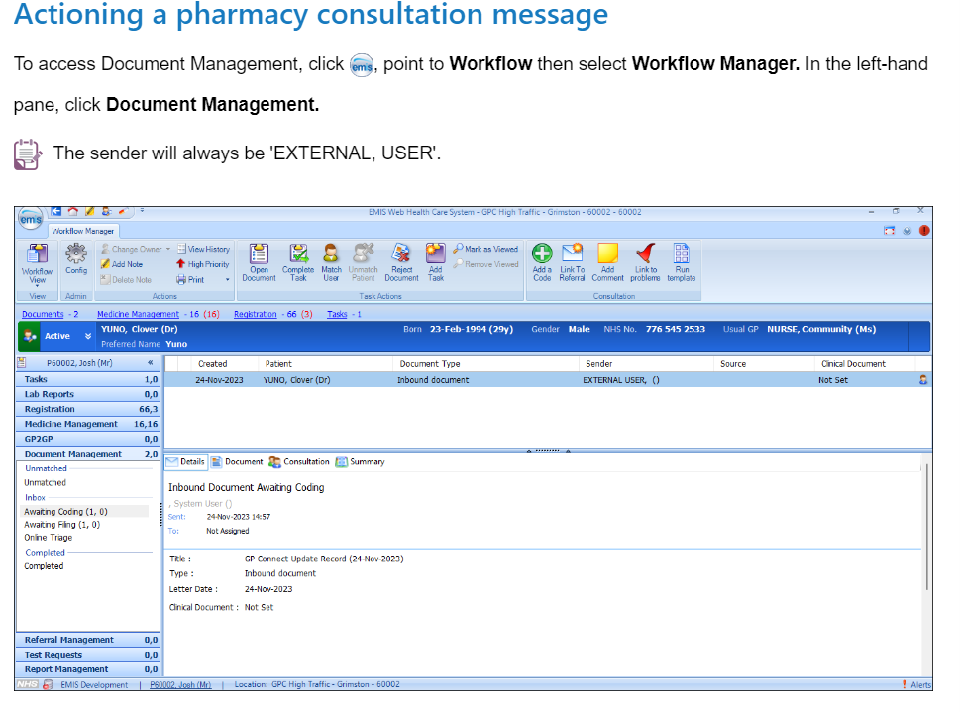
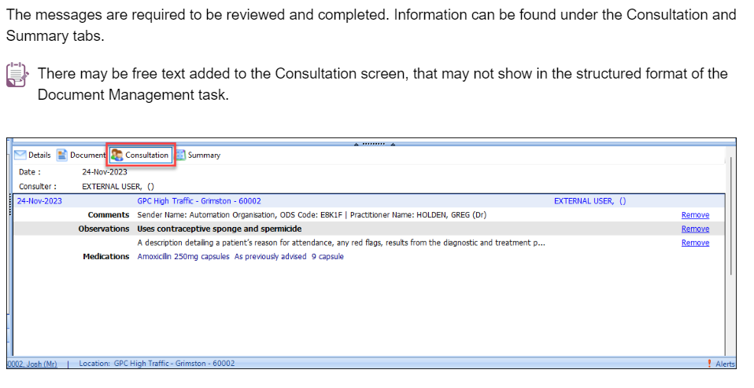
Pharmacy First – Updating patient records after pharmacy consultation
EMIS Web – Actioning a pharmacy consultation message
EMIS have published a step-by-step guide including screenshots on how to action a pharmacy consultation message

Slide 6
Pharmacy First – Updating patient records after pharmacy consultation
TPP SystmOne
TPP SystmOne have released a short video explaining how Pharmacy First in SystmOne.
Access is available via the training platform on logging in to SystmOne - Pharmacy First on SystmOne

Slide 7
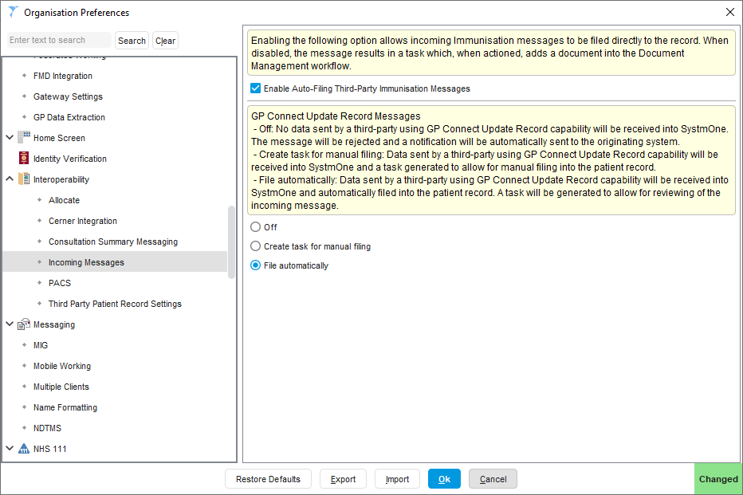
TPP SystmOne – Receiving Consultation Messages
S1 GP Practice can choose how to file Third-party incoming messages
Organisation Preferences➔Interoperability
➔Incoming Messages
- Default is Automatically filing into the patient record and automatically marked as
‘Hidden from Online Services’.
A task will be generated to allow users to review the incoming message and amend the online visibility where appropriate.
Auto-filing can help reduce practice workload and improve patient experience (e.g. reception able to see pharmacy message in records if patient calls practice before practice has managed to review message)

Slide 8
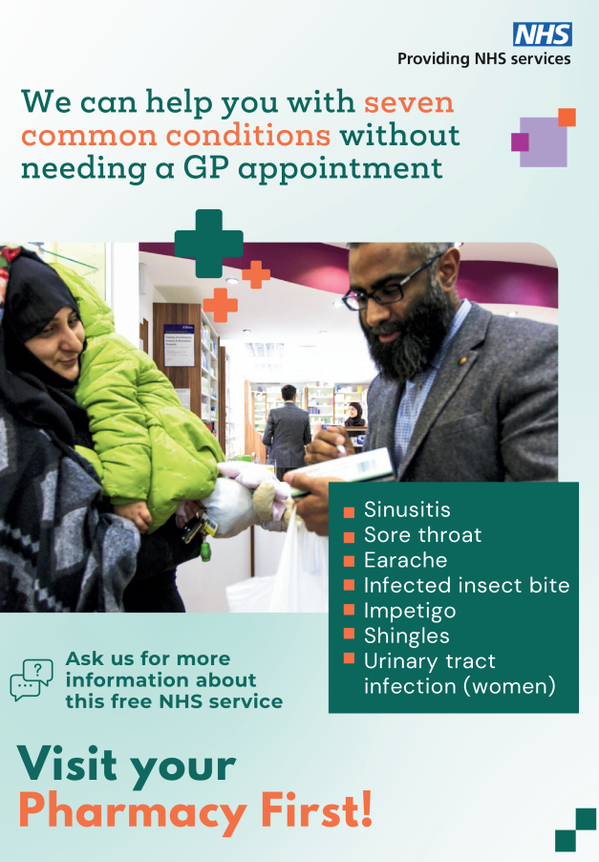
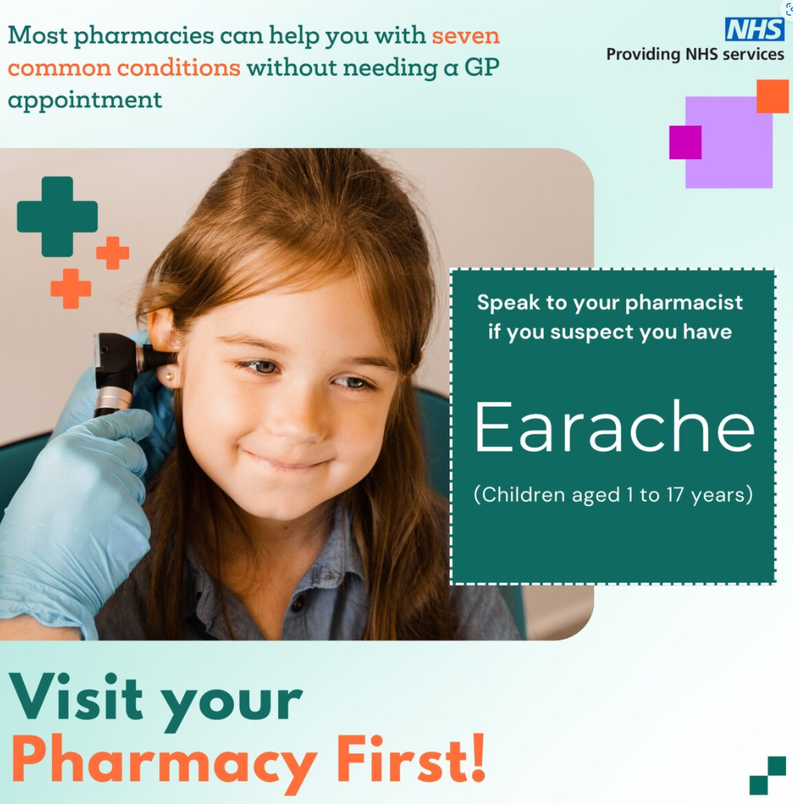
Patient Facing Promotional Materials – Produced by Community Pharmacy England
Community Pharmacy England have produced a number of resources to support community pharmacies and other stakeholders to promote the Pharmacy first Service
Resources Include:
Poster for display within pharmacies
Posters for more general use (e.g. in GP Practice Waiting Rooms)
Social Media Tiles
Link to: Pharmacy First: resources to promote the service

Slide 9
Patient Facing Promotional Materials – Produced by Department of Health and Social Care
NHS England and the Department of Health and Social Care (DHSC) are planning a significant communications campaign for Pharmacy First.
This will feature community pharmacists and is planned to start from the 19th February 2024
Media assets will be available via the DHSC Campaigns resources website:
Campaigns | Campaign Resource Centre (dhsc.gov.uk)

Slide 10
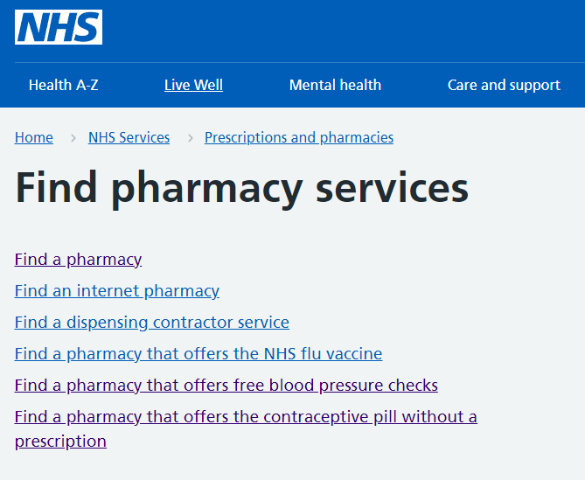
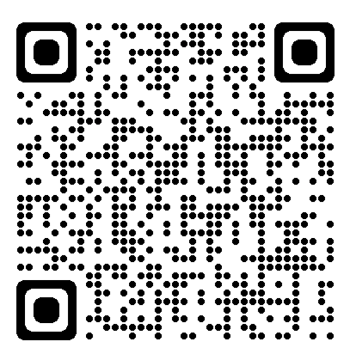
Find Pharmacy Services - NHS (www.nhs.uk)
Find Pharmacy Services can be accessed by patients via the nhs.net website
The searches enable patients to find what out what services local pharmacies are offering.
Helps explains to patients who is eligible for service and what to expect

Slide 11
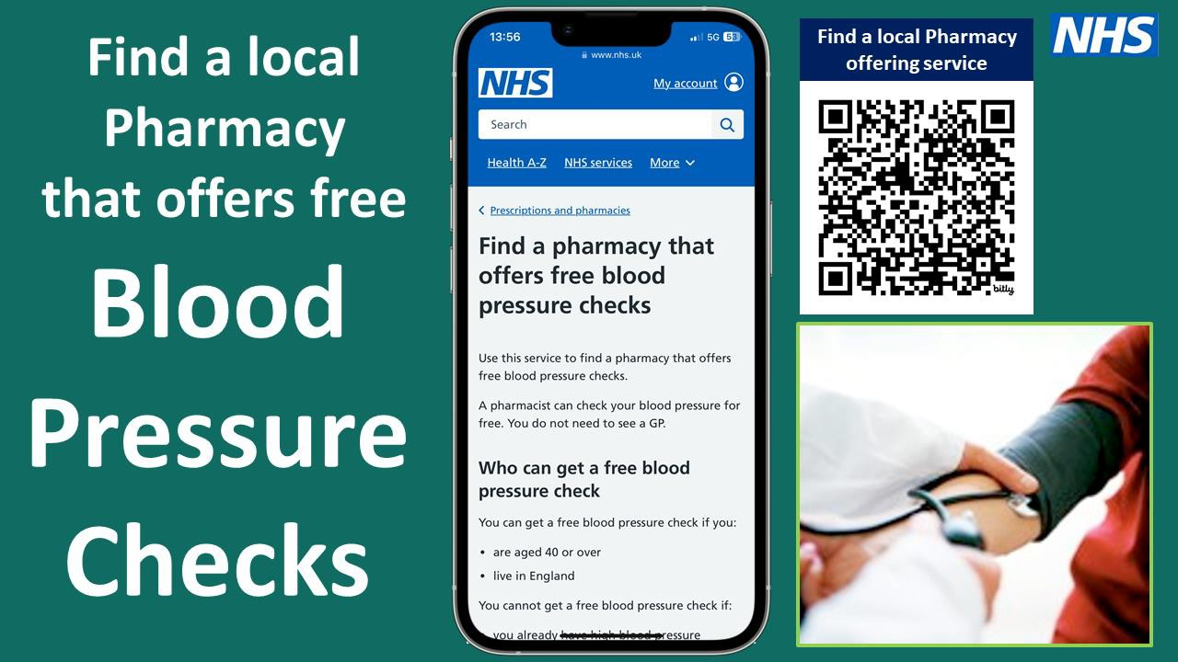
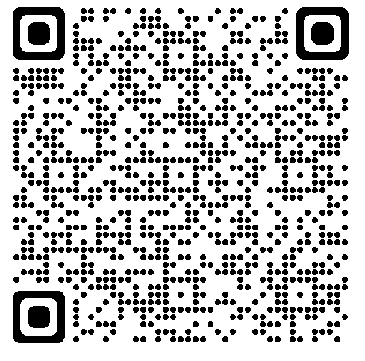
Find a pharmacy that offers free blood pressure checks - NHS (www.nhs.uk)
https://youtu.be/MqR_a1DitOE

Slide 12
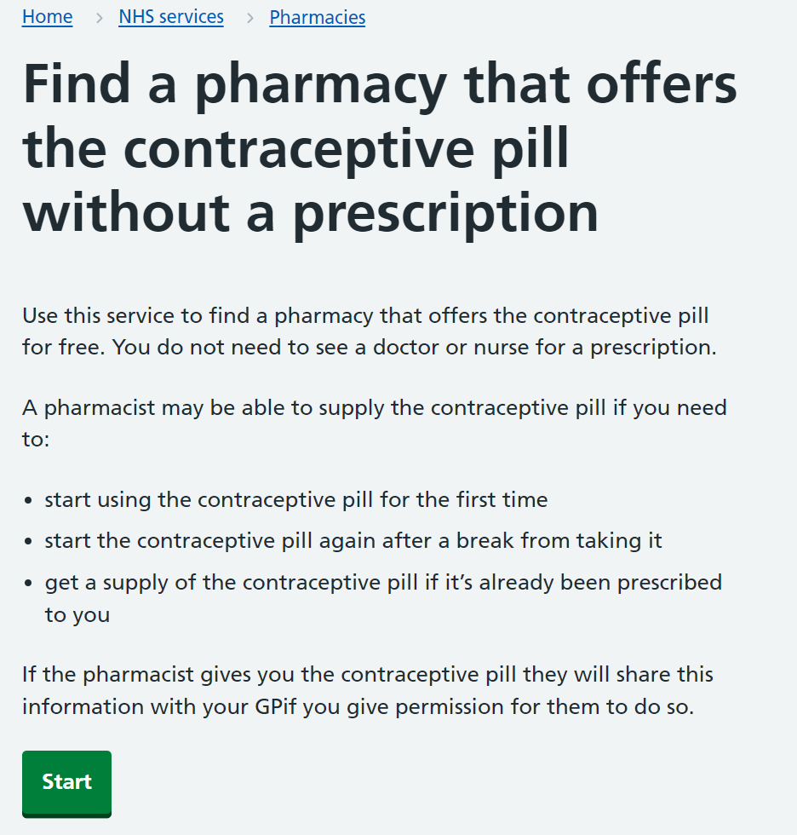
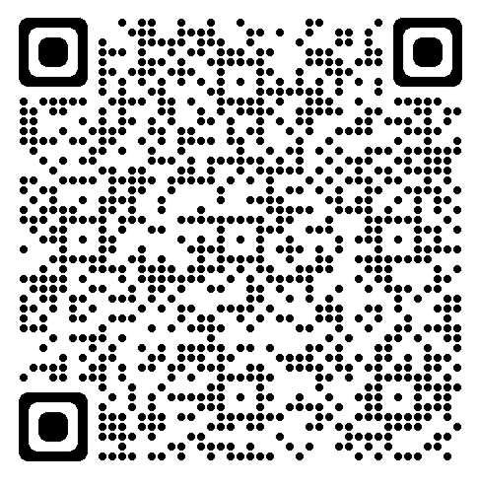
Find a pharmacy that offers the contraceptive pill without a prescription - NHS (www.nhs.uk)

Slide 13
SMS/Email Message Preset Templates 1
Blood Pressure (BP) Check at Pharmacy
Dear <title> <forename> <surname>, You can get a free blood pressure (BP) check at a local pharmacy by using this link: https://bit.ly/pharmacybloodpressurecheck If you encounter any issues, please contact us back. Regards <staff_member_title> <staff_member_forename>
<staff_member_surname> - <organisation_name>
Oral Contraception Service at Pharmacy
Dear <title> <forename> <surname>, You can seek free Oral Contraception from a local pharmacy by using this link: https://bit.ly/nhspharmacyservices If you encounter any issues, please contact us back. Regards <staff_member_title>
<staff_member_forename> <staff_member_surname> - <organisation_name>
**Caution: Likely will be replaced with a new dedicated URL link from 1st Dec 2023**
Use Short URL links (e.g. bitly) & shorter messages than these examples above to save SMS fragments

Slide 14
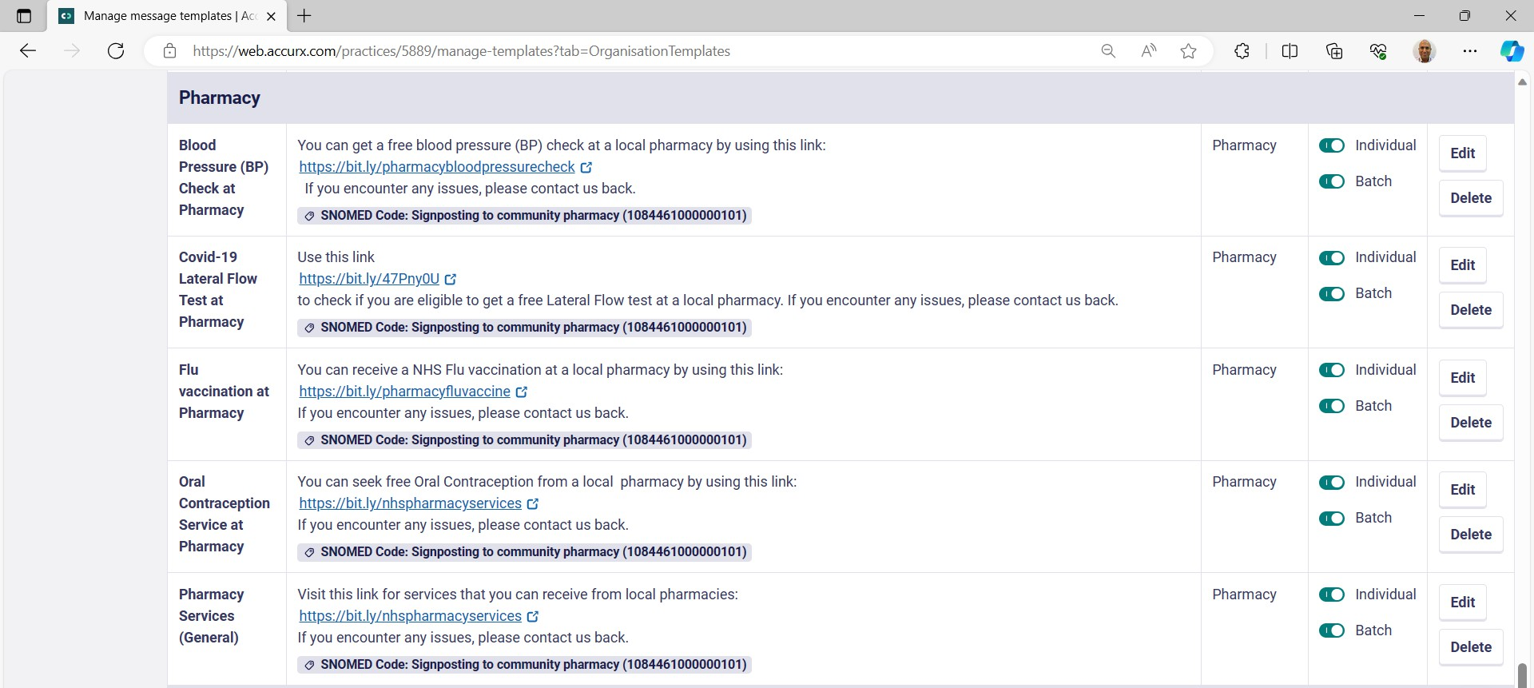
Accurx - Template Messages
- If there are no suitable templates from accurx, then create some for your
organisation. Remember to add suitable ‘Signposting to community pharmacy’ or ‘Pharmacy First’ SNOMED codes linked to each template

