Slide 1


Lung Cancer Screening
GP Toolkit
This toolkit provides Primary Care with key information about the Lung Cancer Screening (LCS) programme at a national and local level. It also describes how it will benefit your patients and ways you can support the programme and encourage eligible patients to attend.

Slide 2
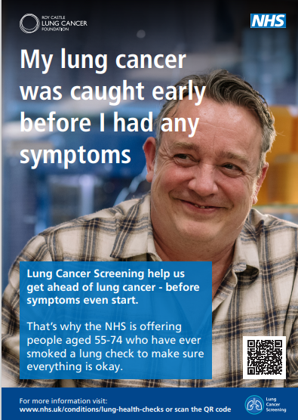
About Lung Cancer Screening
General Information:
The national Lung Cancer Screening (LCS) programme is operated by NHS England and is contributing to the NHS Long Term Plan to improve early diagnosis and survival for those diagnosed with cancer.​
The LCS programme targets those most at risk of developing lung cancer, i.e. people aged 55-74 years who have a history of smoking.
The LCS programme aims to find lung cancer early, sometimes before someone has symptoms:​
  Approximately three quarters of people who are diagnosed with lung cancer through the programme are caught at an early stage (stages 1 or 2), when lung cancer is easier to treat with curative intent.
  Without such early intervention, less than a third of lung cancers are caught at an early stage.​

Slide 3

About Lung Cancer Screening (Continued)
History:
  The programme originally launched in 2019 as the Targeted Lung Health Check (TLHC) programme with ten pilot projects from Integrated Care Boards who had some of the highest rates of mortality from lung cancer. ​
  In June 2023, it was announced that the TLHC programme would be rolled out nationally, covering the total eligible population by 2028.​
  In September 2024, the National Cancer Team announced that the TLHC programme would transition to become the national Lung Cancer Screening (LCS) programme by April 2025.
  The LCS programme’s national roll-out continues - there is now at least one site live in each of the 21 Cancer Alliances.

Slide 4
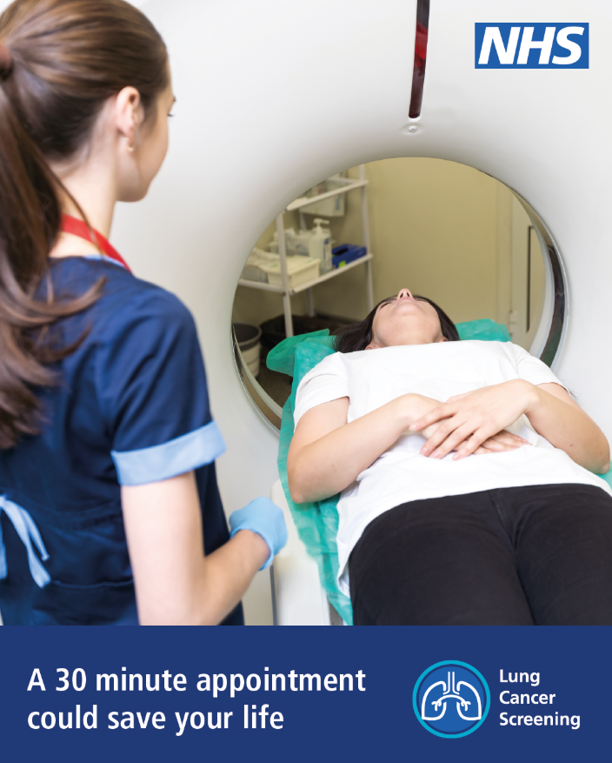
Benefits to patients
​LCS helps us to get ahead of lung cancer, sometimes before symptoms start. ​
People diagnosed with lung cancer at the earliest stage are nearly 20 times more likely to survive for five years than those whose cancer is caught late.​
People diagnosed with early-stage disease may also benefit from less invasive treatments, such as keyhole surgery. Many people diagnosed through the programme do not need additional treatment, such as chemotherapy. ​
Programme participants who are still smoking are offered smoking cessation advice at their Lung Health Check and a referral to their local Stop Smoking Service, whilst all participants are given advice on how else they can improve their overall lung health.​
Watch Dr Jason Page and Dr Tina George discuss the benefits to patients: https://youtu.be/LWMJu_FN_0Q

Slide 5
The STW Lung Cancer Screening Programme

Slide 6
The LCS Programme in Shropshire, Telford and Wrekin
The LCS Programme in Shropshire, Telford and Wrekin will begin in September 2025 and will be phased across 4 years, prioritising areas with highest deprivation levels first, starting in South Telford.
To support the delivery of the local LCS Programme, NHS Shropshire, Telford and Wrekin has appointed Alliance Medical (working in partnership with Xyla Elective Care and Telemedicine Clinic) as its LCS service provider.
The LCS process is set out below:
Eligible participants, identified through GP records, will be sent a letter informing them that they have been selected to receive a Lung Health Check (LHC) which will be conducted via a telephone call. Along with the letter, each participant will receive an information booklet so that they can make an informed choice.
During this LHC telephone call, participants will be asked a series of questions about their lifestyle, breathing, family and medical history; they will also be asked to verify their height, weight and smoking status (past and current) – any participant identified as a current smoker will be offered a referral to their nearest Local Authority Stop Smoking Service.
From the information gathered at their LHC, a risk score will then be calculated for each participant.
Any participants receiving a low-risk score will exit the LCS programme at that point.

Slide 7
The LCS Programme in Shropshire, Telford and Wrekin (continued)
Those receiving a high-risk score (i.e. those more likely to have lung cancer now or in the future) will be invited to attend a face-to-face clinical review and receive a low dose CT scan.
The result of the scan will then determine what happens next, i.e.:
People with suspected cancer will be referred into the appropriate suspected cancer assessment and diagnosis pathway.
If no abnormality is found a person will be invited back for subsequent scans every two years, until they are over the age of 74, at which point they will age-out of the programme.
Some people may require further surveillance scans, e.g. to monitor the growth of a small nodule. They will be invited back for a scan at regular intervals (i.e. at 3 months and 12 months following the initial scan).
Some people may have a scan that shows signs of another problem (not cancer) that requires medical advice. Depending on the type and severity of these Incidental Findings, participants may either receive a referral to Secondary Care or be advised to contact their GP for further support.
Each Participant, along with their GP, will be informed of their LCS results and outcome by standard letter (as per the LCS Outcome Protocol – Routine Findings). If a condition is identified through the LCS programme that requires critical or urgent medical attention, the Participant will also be informed soonest by telephone (as per the LCS Outcome Protocol – Critical/Urgent Findings).

Slide 8
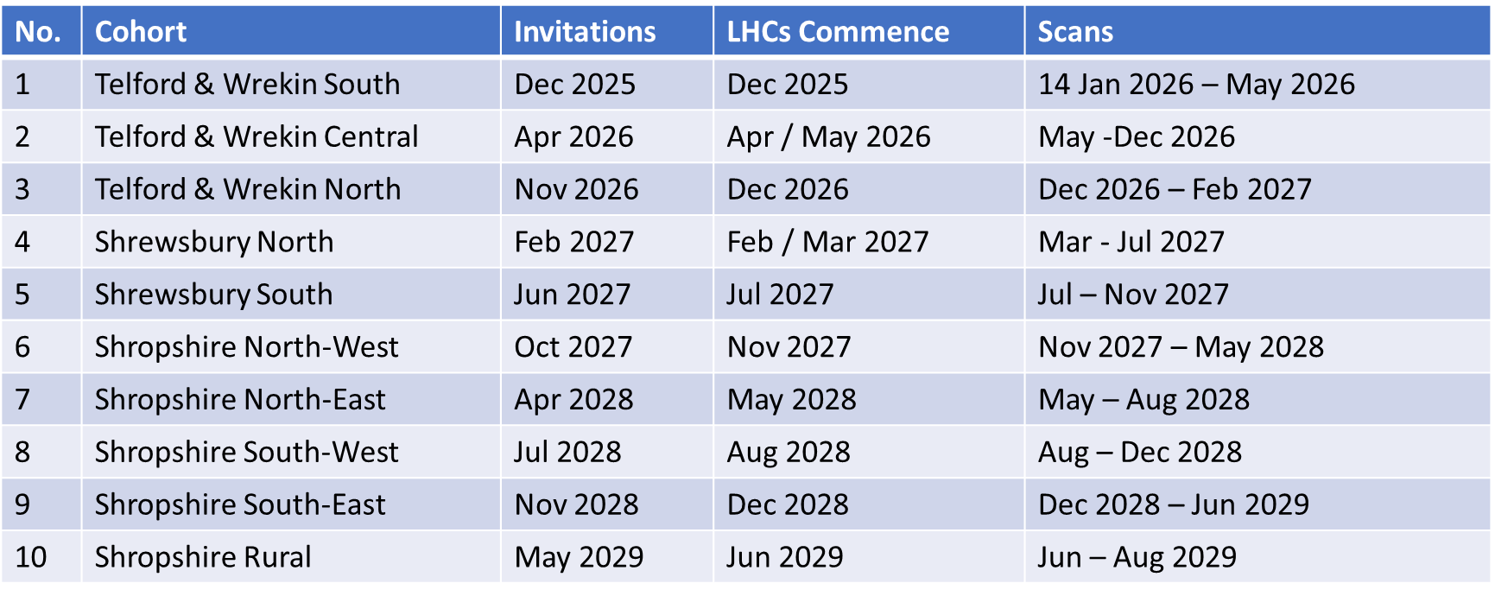
STW LCS Roll-out Plan

Slide 9
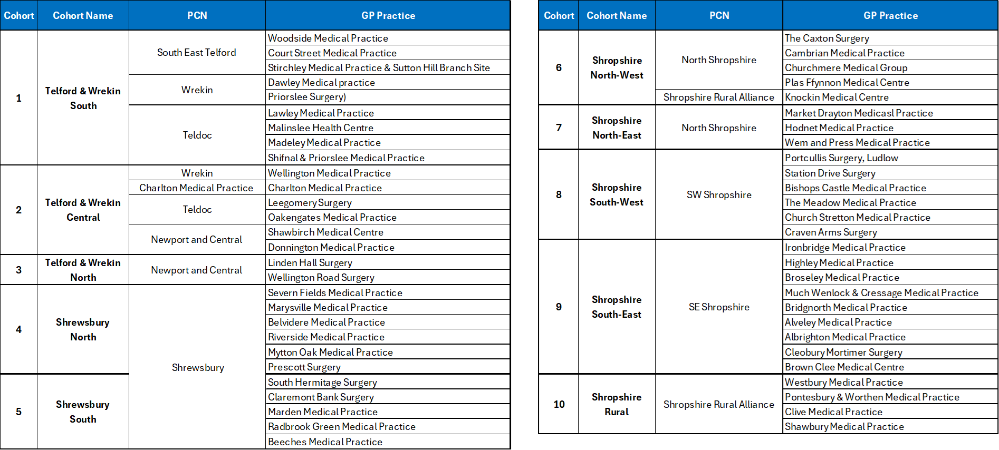
STW LCS Cohorts – GP Practices

Slide 10
Support from STW GP Practices

Slide 11
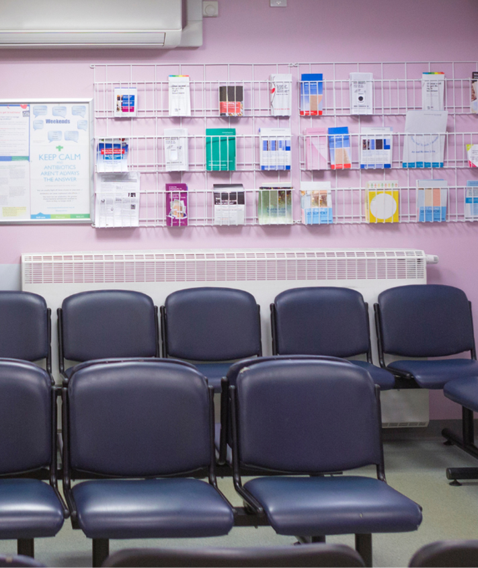
How your practice can help
We want your patients to get maximum benefit from the LCS programme. You can help raise awareness and increase uptake by: ​
  Checking all patient records are up-to-date with smoking status codes to ensure everyone eligible is invited for a lung cancer screening
    Sending text messages to patients (e,g, via Mjog or Accurx) asking them to confirm their smoking status. ​
  Signposting eligible patients to the programme e.g. noting via appointments who is eligible and checking patient records to see if they have been invited.​
  Briefing everyone in the practice team about LCS before it launches in your area, so that they can provide patients with information and reassurance about the programme.
  Displaying posters and having leaflets in the practice waiting room.
  Playing videos on waiting room screens.​
  Placing information about the programme on the practice website.​
  Posting information about the programme on your social media channels.​
All the resources to support you in promoting the LCS programme are available to download here Lung Cancer Screening - NHS Shropshire, Telford and Wrekin

Slide 12
Lung Cancer Screening Outcomes - Incidental findings
We understand that some GP practices might be concerned about the amount of additional workload associated with supporting lung cancer screening; in particular, the number of incidental findings identified and referred into primary care.
Watch Dr Jason Page and Dr Tina George explain the impact of incidental findings on practices and the ways they are supporting patients: https://youtu.be/XalbZYp7TdI
The amount of workload going to primary care will vary substantially based on:​
  local LCS Outcome Protocols and,​
  any primary care support models (if available).
STW ICB has worked closely with representatives from Primary Care, Secondary Care and Alliance Medical to:
reduce the administrative burden for primary care, by adopting standardised letters featuring SNOMED Codes
utilise nationally-agreed standardised clinical pathways for the most prevalent incidental findings, and
develop and agree local LCS Outcome Protocols to refer participants efficiently to primary or secondary care
The Incidental Findings clinical pathways and LCS Outcome Protocols can be found at: https://www.shropshiretelfordandwrekin.nhs.uk/our-work/cancer/lung-cancer-screening/

Slide 13
Communication resources

Slide 14
Key messages
Lung cancer causes more deaths than any other cancer in the UK. It is commonly diagnosed too late, due to there often being no symptoms at the earlier stages.
The LCS programme helps save more lives, by identifying lung cancer at an earlier stage, when it is much more treatable. When lung cancer is diagnosed early there are more options for treatment and a higher chance of survival - people diagnosed with lung cancer at the earliest stage are nearly 20 times more likely to survive for five years than those whose cancer is caught late.
Lung Health Checks are offered to people who are registered with a STW GP Practice, are aged 55 to 74 and who are current or former smokers.
The LCS programme is initially being offered in areas with the highest lung cancer mortality rates.
Overall, more than 1.5 million people have been invited for a Lung Health Check across the country, with an estimated 5,500 lung cancer cases being caught earlier.
Other conditions can also be identified through the programme. If this happens, participants will be referred on for the appropriate treatment.
All current smokers that participate in the programme will be offered a referral to a Local Authority Stop Smoking Service where they will receive free behavioural support and Nicotine Replacement Therapy.

Slide 15
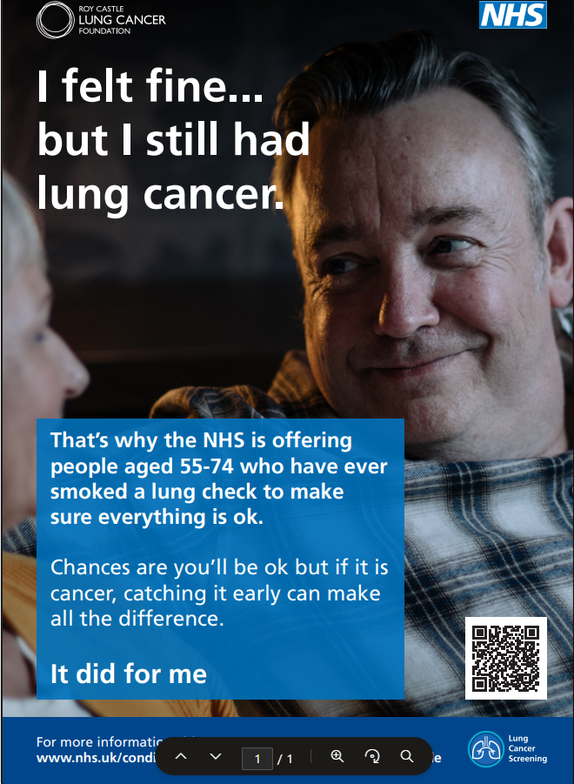
Promotional and Information Resources
A range of promotional and information resources have been developed to help promote the STW Lung Cancer Screening Programme, including:
Information Leaflet
GP Screen and posters
Information in Easyread
Social media graphics
Frequently Asked Questions (FAQs)
These may be accessed and downloaded by visiting:
Lung Cancer Screening - NHS Shropshire, Telford and Wrekin

Slide 16
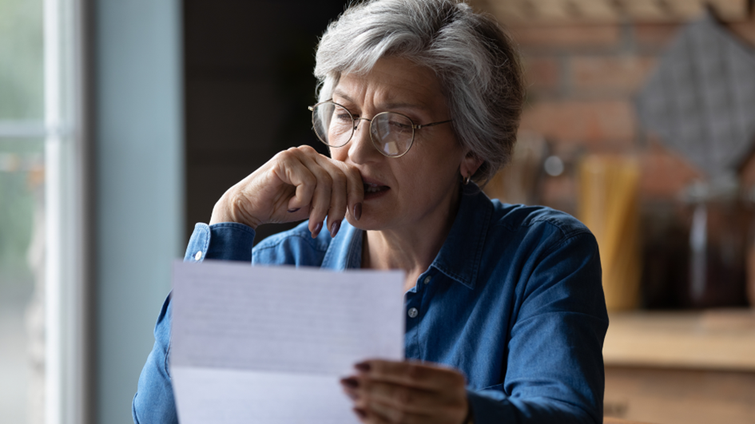
Frequently asked questions (FAQs)
FAQs from Patients
Lung Cancer Screening is a relatively new initiative so some patients may, if they are a little confused or anxious about attending an appointment, seek reassurance from their GP practice. ​To assist with this, The Roy Castle Lung Cancer Foundation has put together the answers to some of the most commonly asked questions by patients, which can be accessed through the Roy Castle Lung Cancer Foundation’s website:
Lung Health Checks to Detect Lung Cancer Early | RCLCF
FAQs from GPs
Similarly, answers to some of the most commonly asked questions by GPs can be found on the NHS STW Website:
https://www.shropshiretelfordandwrekin.nhs.uk/wp-content/uploads/FAQs-for-UK-General-Practitioners.docx

Slide 17
Videos
For GP practices
Dr Jason Page and Dr Tina George discuss the Lung Cancer Screening programme, the benefits to patients and primary care and the requirements from GP practices. ​
Click the links below to watch the full-length video, or to get answers to specific questions around LCS:
  Full length video​
  What are Lung Cancer Screening and what impact are they having? ​
  How are Lung Cancer Screening helping people affected by lung cancer? ​
  What are the benefits to GPs and practices? ​
  What is required from GPs when implementing a Lung Cancer Screening ? ​
  What are the main challenges? ​
  How are practices supported? ​
  What are your hopes for lung cancer screening in the future?
For patients
  Why should you attend even if you feel well
  What is a CT scan

Slide 18
Useful links and support
You can find more information about lung cancer and advice on quitting smoking by clicking on the following links:
Support to stop smoking - Shropshire
Help to stop smoking - Telford and Wrekin
NHS Lung Cancer Information
NHS Quit Smoking
Cancer Research Lung Health Checks
Cancer Research Lung Cancer
Cancer Research Causes of Cancer
Roy Castle Lung Cancer Foundation
Macmillan Cancer Support Lung Cancer

Slide 19
If you have any questions, concerns or feedback, please contact the Alliance Medical support team:
Phone: 0330 236 8484
(phone lines are open Monday to Friday, 8am - 7pm, and Saturday, 9am - 5pm)
Email: xyla.stwlungcancerscreening@nhs.net

