Slide 1
Eye-care Transformation Programme

Slide 2
Update: December 2022
Progress update
The programme continues to progress well with four groups now overseeing the design and development work on new models of eye-care and pathways, including:
Eye-care Referrals Group looking at referral pathways and processes, and the implementation of electronic eye care referrals that will go directly from optometry to secondary care, and enable virtual and remote reviews. This will remove the need for sending an eye-care referral via the GP helping to lift some of the pressures from primary care and also preventing unnecessary hospital visits for patients;
Single Point of Access Group looking at one entry point for the system into eye-care that will provide a processing and triage function, and pull the patient to the appropriate service and care setting, first time, in a timely way. This will provide some much needed clarity on a simpler to navigate eye-care system with one entry point to services;
Optometry First Group developing an enhanced model of what can be provided in an optometry setting, providing more services in people’s local communities and high street optical practices. This will help prevent unnecessary hospital appointments for certain things that will benefit both the patient and the service provider;
Ophthalmology Group looking at what needs to be provided within ophthalmology and how those services, teams and pathways and processes work. This includes not only the Shrewsbury and Telford Hospital NHS Trust but also the ophthalmology provision of independent sector providers.
These pieces of work on new proposed pathways and models are currently being finalised, and tested from various perspectives to ensure they are safe, effective, sustainable, deliver high quality outcomes and improvements, and are value for money.
Next Steps
Finalise draft proposed new eye-care models and pathways and identify what is needed to enable them.
Detailed cost, impact and benefit modelling.
Begin to implement the Electronic Eye-care Referrals System. Find out more here.
Second round of engagement early 2023 to share proposed models and pathways and seek further feedback and comment. This will be used to refine the work where necessary and appropriate.

Slide 3
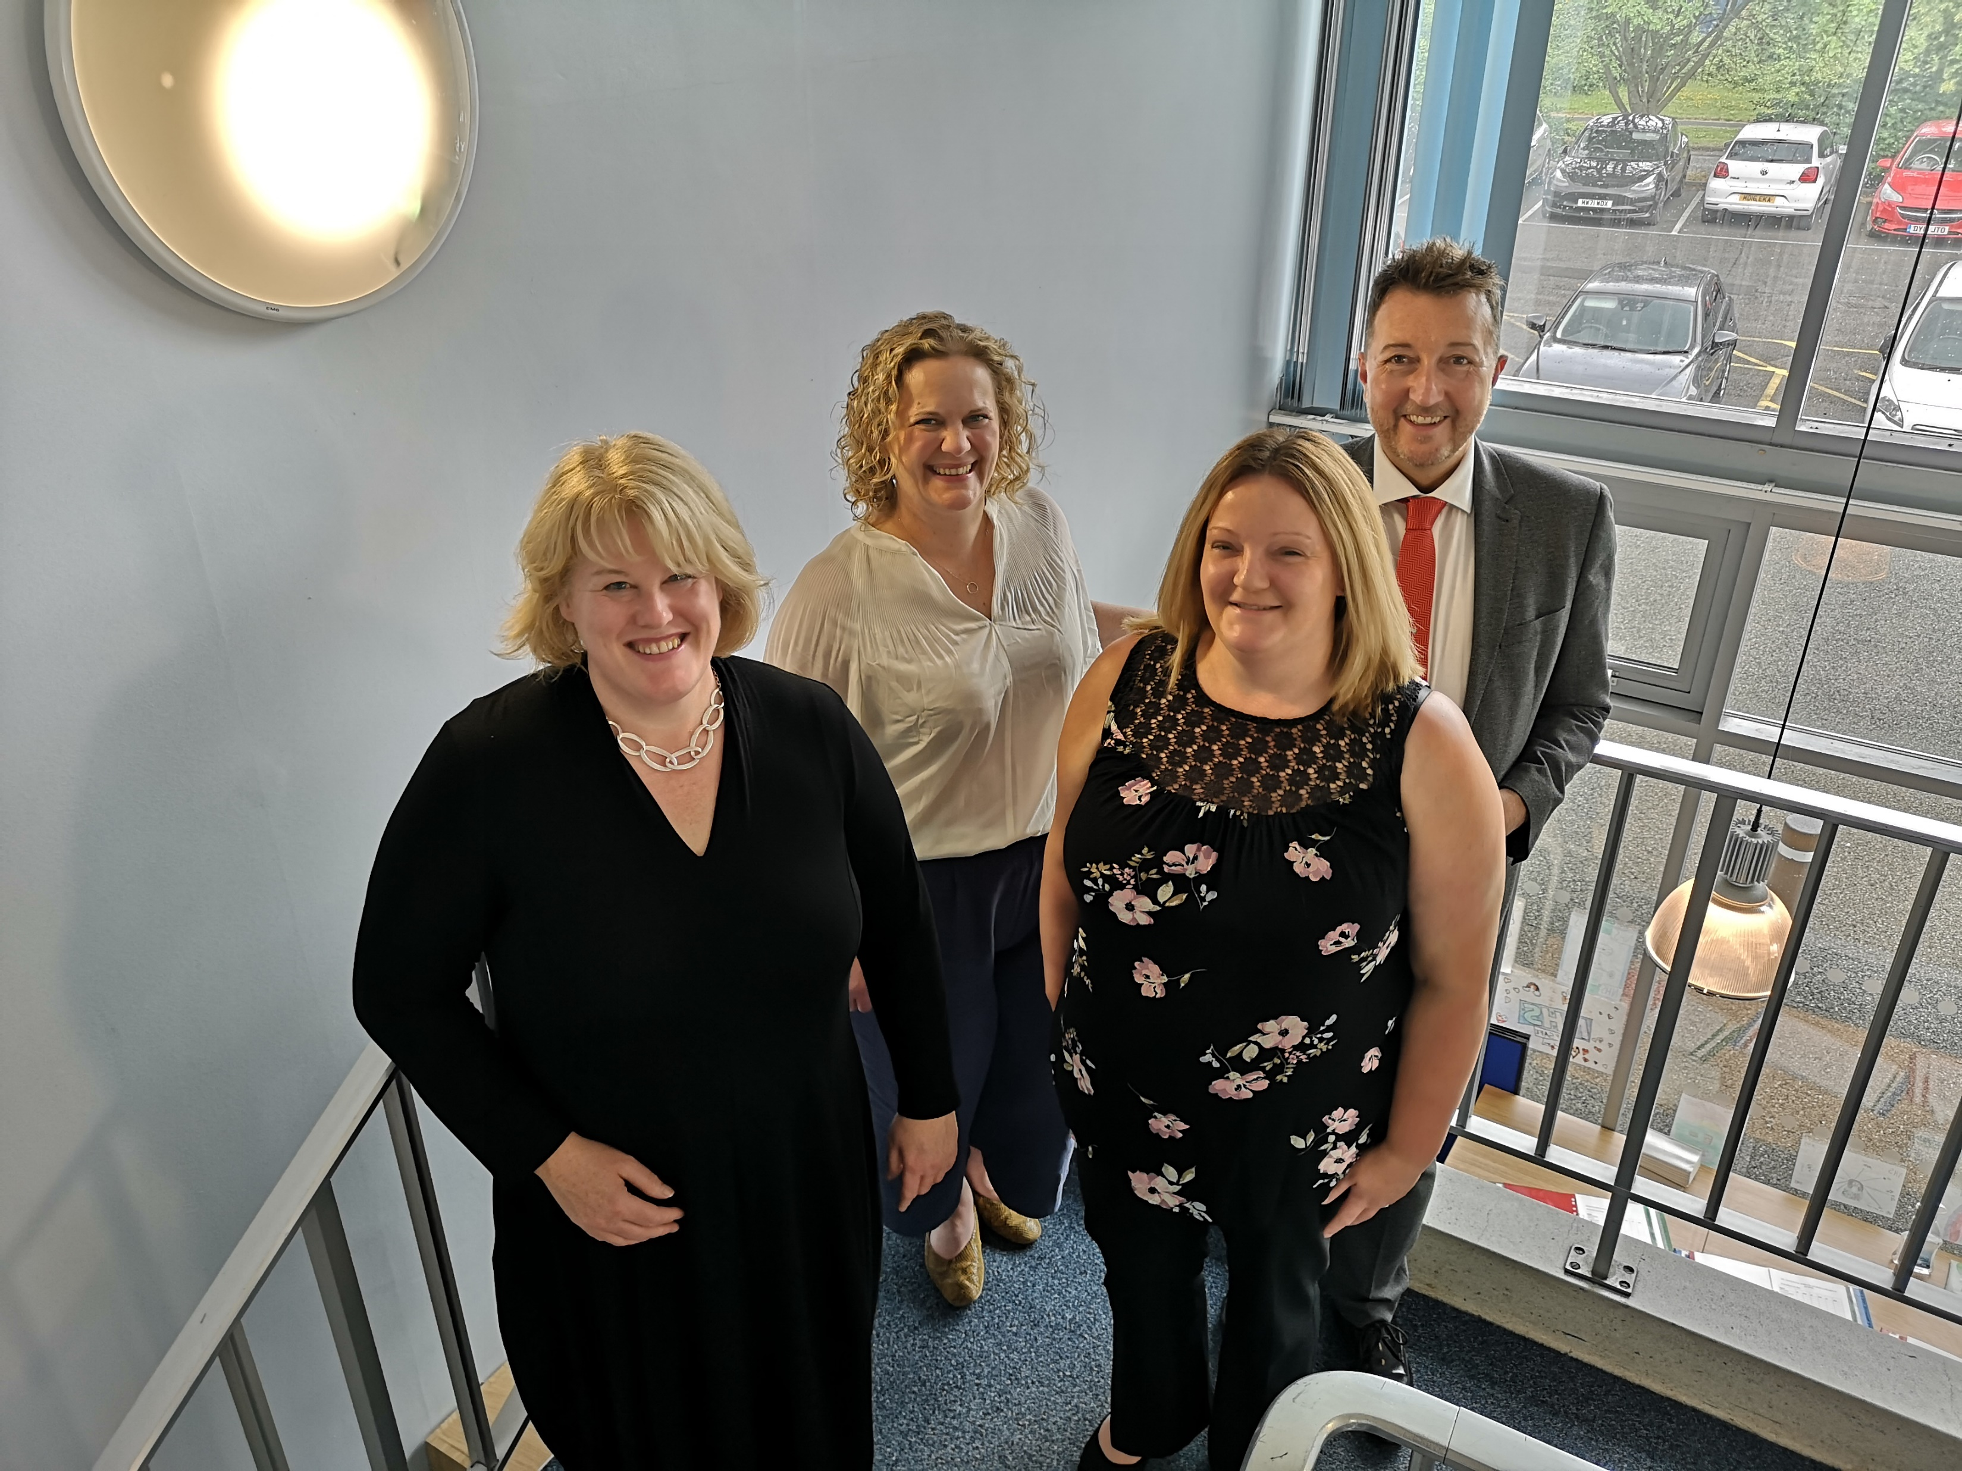
Upcoming engagement sessions
We are holding a number of online sessions, as well as planning to get out into communities to talk to people about the proposed future model of care, to share our designs and check that it reflects what people have told us and meets the needs of the population.
The online sessions include:
A public session (for members of the public, patients and carers) -Tuesday 7th February 5.30pm to 7.30pm
A clinical session (for staff working in eye-care services) - Wednesday 8th February 12.00pm to 2.00pm
An independent sector session (for independent eye-care providers) - Tuesday 14th February 10.30am to 12.30pm
If you would like to express an interest in attending one of these sessions or would like to suggest any groups for us to engage in this work, please contact Lucy Jones at lucy.jones17@nhs.net
Meet some of the programme team (from left to right): Claire Roberts (clinical lead); Marie-Claire Wigley; Lucy Jones; and Barrie Reis-Seymour

