Slide 1

<Name>
<Job Title>
<Organisation>
<About You>
<About You>

Slide 2


How to update your Teams background
In PowerPoint, complete the text boxes with information about you, including your name, job title, organisation and short details that reflect your hobbies and interests eg. 'Football fan' or ' Home baker'
DO
Make sure text fits neatly in the rainbow – use a second line if needed
Keep information short and sweet
Make sure text is aligned
Keep the text black – to make sure it is accessible
Express yourself
DON'T
X Let text fall outside of the rainbow sections
X Be shy!

Slide 3
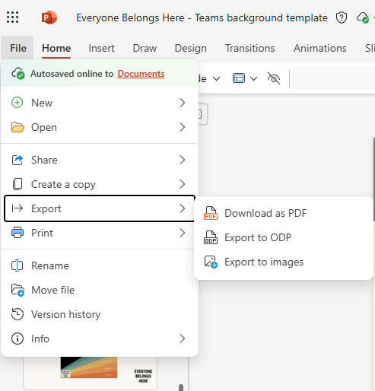
How to update your Teams background
2. Now you need to export your design as an image file. Click File >> Export >> Export to images

Slide 4
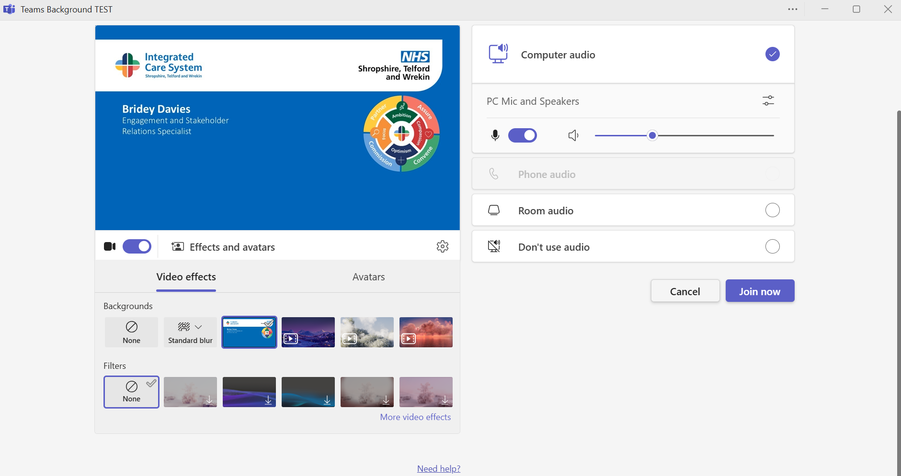
How to update your Teams background
3. When the file has downloaded, extract all from the zip file. Your Teams background is now saved on your PC.
4. To upload your background, you need to be ready to start a Teams call – you can set up a dummy call with yourself to make this easier. Click Effects and avatars >> More video effects

Slide 5
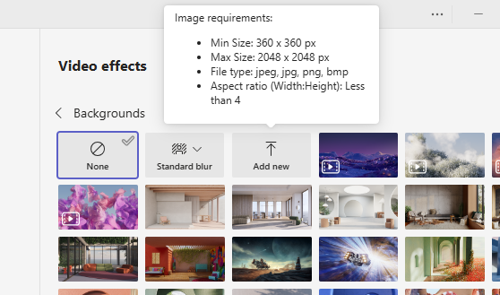
How to update your Teams background
5. Click 'Add new'

Slide 6
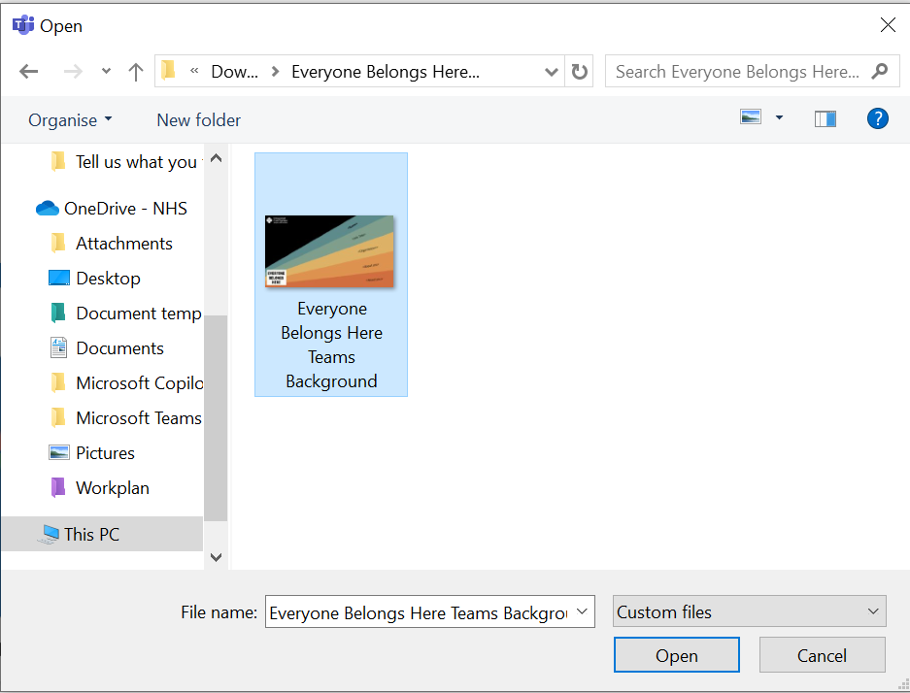
How to update your Teams background
6. Select your file and click 'Open'

Slide 7
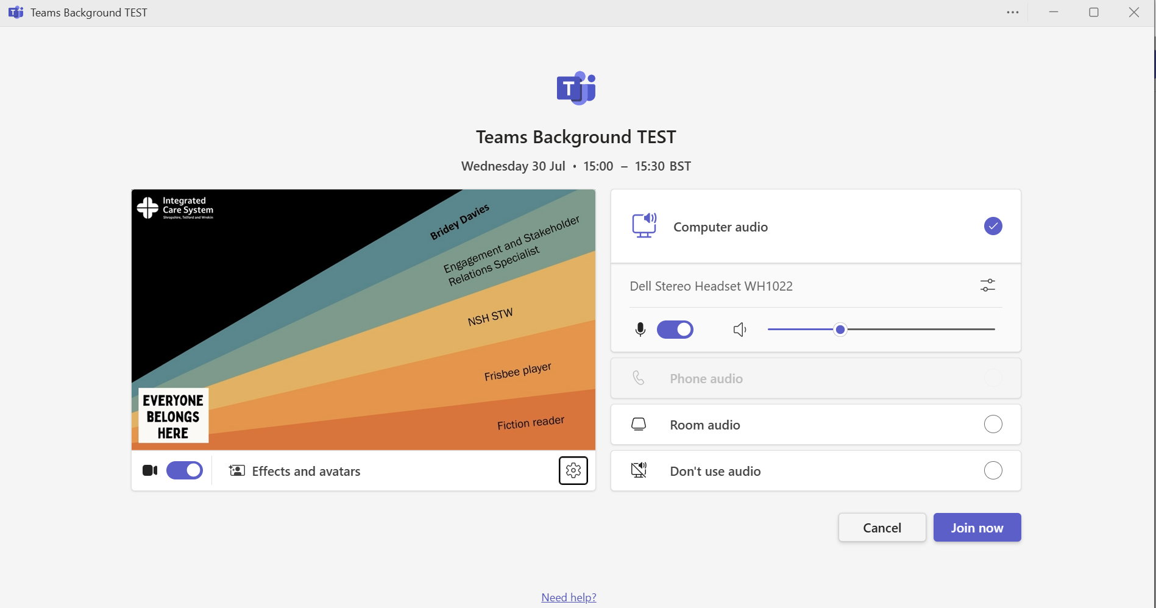
How to update your Teams background
7. Your background will appear in the preview pane, and you are ready to join the call!

