Slide 1
Community Diagnostic Centres briefing
May 2022
For more information contact george.cooper36@nhs.net

Slide 2
Community Diagnostic Centres
Working groups are meeting regularly including: Workforce; Estates; Digital; Clinical (pathways design).
The CDC will be sited in the TF3 area of Telford (Stafford Park 1) .
Development of the first CDC is well underway, including: agreeing the lease for a property, securing utilities, preparing the interior, procuring equipment; and staff recruitment plans.
A new diagnostic suite is aslo being built on the Royal Shrewsbury Hospital site, the first step in separating elective from urgent scans.
Subject to engagement, we are proposing to site three further CDCs in the county over the next few years (Shrewsbury, North Shropshire and South Shropshire).
The proposal is to transform diagnostic services through the introduction of Community Diagnostic Centres (CDCs), previously known as Community Diagnostic Hubs, based on a national recommendation following Sir Mike Richards' review of diagnostic capacity (2020).
It will see elective diagnostic tests delivered away from acute hospital sites and separately from urgent diagnostic scans. Reducing waiting times for non-urgent tests and risk of cancellation, improving patient experience and outcomes.
STW has been successful in being allocated £4.5 million of capital funding to develop and open a pilot CDC in the Telford area. This is set to open by the end of the year (2022).
The capital funding is backed up by an initial revenue fund of more than £2.4 million to support staffing, leasing and expected requirements.
Why Telford? Telford is within 10% of the most deprived areas in England and Wales meaning it is a location with high health inequalities
Early engagement work has taken place, with nearly 1,300 responses to our questionnaire
Four out of five (80%) agreed that there is a need for CDCs in Shropshire, Telford and Wrekin
82% of people agreed the NHS should invest in CDCs
76% of people stated that it would make it easier for patients to access services.
Proposed services and equipment in our 1st CDC include
CT (a series of X-ray images taken from different angles around the body)
Non Obstetric Ultrasound Scans (non-invasive scans)
X-Ray
ECG (Electrocardiograms)
Clinic rooms
Phlebotomy (blood tests) with some on site point of care sample analysis.

Slide 3
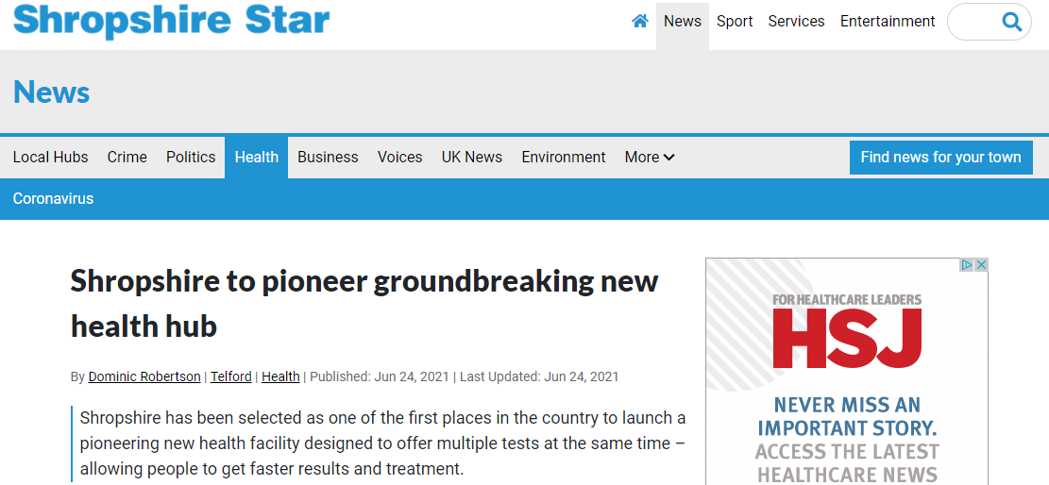
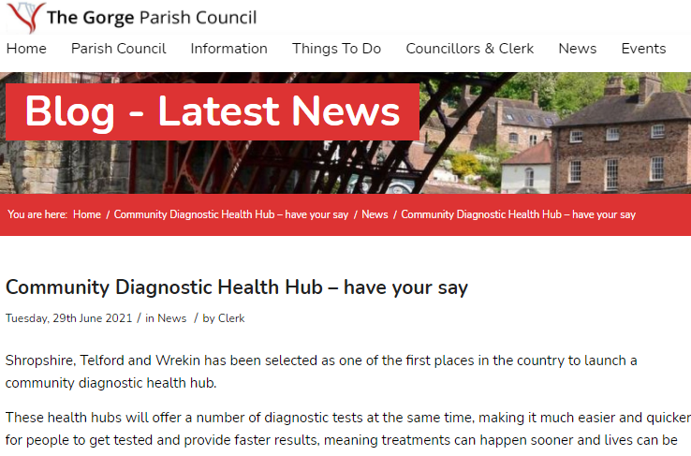
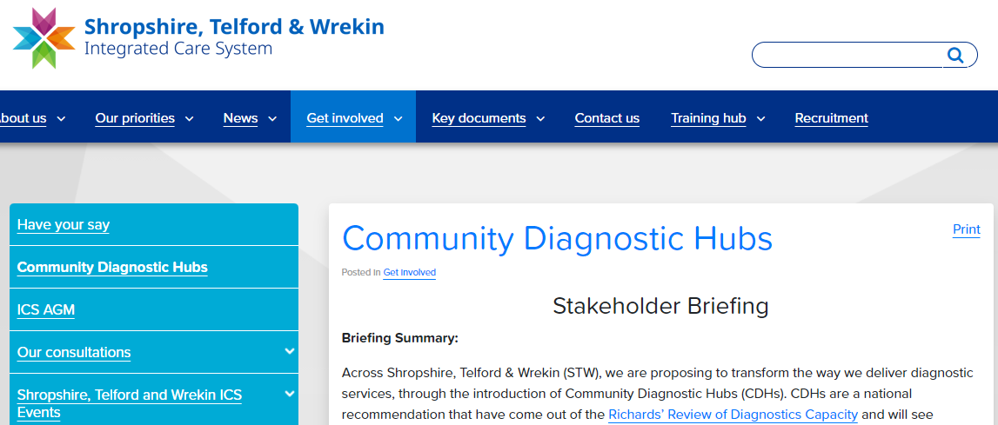
Early Engagement (nearly 1,300 responses to our survey)
April 2021
May 221
July 2021
Sept 2021
Nov 2021
Dec 2021
2022 +
2021 - 22

Slide 4
Survey Findings
Satisfaction with current testing services is good, but some criticism of Imaging and Heart and Lung testing
Community Diagnostic Hubs were well received by participants
Positive opinion of Community Diagnostic Hubs was shared across all groups
Community Diagnostic Hubs meet key service improvement needs
Community Diagnostic Hubs are expected to increase capacity and improve services
Community Diagnostic Hubs will help make services more accessible
There are some concerns about how Community Diagnostic Hubs will be staffed
There is potential for Community Diagnostic Hubs to extend the services offered
NHS staff were also positive towards Community Diagnostic Hubs, but had some concerns about staffing
Opinion about the pilot location varied by where respondents lived – any location must be car friendly
2022 +

Slide 5
CDC Benefits
Dedicated community diagnostic sites to support patients separate to the acute hospitals
Additional capacity in the county
Additional support to cancer pathways
Extra capacity to help meet the increased demand for diagnostics magnified by the pandemic
Reduce the number of people needing to visit acute hospital environments
Separation of Acute & Elective Diagnostics
Separation from the acute hospitals will help keep CDC locations free from COVID
One site which will eventually support all imaging and key diagnostics tests

Slide 6
CDC Road Map
April 2021
Initial submission
Initial submission to NHSE/I for year one CDC
Outline Business Case (OBC)
Prepare OBC, including proposed location, planned pathways and costings. Public engagement planned and launched.
May 2021
OBC
Detailed OBC submitted detailing proposed planned pathways, activity, costings and potential further expansion.
July 2021
Financial award confirmed
NHSE/I confirm a capital investment of £4.5m and a revenue investment of £2.4m
Sept 2021
Planning
Identify and confirm a suitable site and develop the design. Planning for workforce and clinical pathway requirements
Nov 2021
Next phase
Continued development of the first CDC. Explore and analyse data and feedback in readiness for years 2-5 CDC development
Dec 2021
Onsite work
Agree final design and start onsite work
2022 +
2021 - 22
CDC development
Initiate contractual agreements with Estates, finalise drawings, and undertake a tender exercise

