Slide 1
Shropshire, Telford & Wrekin
Children & Young People’s
Mental Health Transformation Plan – Update 2023
Complied by: Shropshire, Telford & Wrekin ICB, Midlands Partnership University Foundation Trust, Shropshire Council and Telford & Wrekin Council
November 2023

Slide 2
Introduction
This Children and Young People’s (CYP) Local Transformation Plan (LTP) gives an update of the emotional health and wellbeing (EHWB) services for CYP living in Shropshire Telford and Wrekin (STW). The update captures an overview of current services, recognising the challenges in the system and identifies the transformation and commissioning during 2024/25.
Using the system vision, the plan set out several next steps to ensure the system and its partners, through coproduction, continue to strive to continue to improve the EHWB services for CYP living in Shropshire and Telford & Wrekin.
Gareth Robinson
Director for Delivery & Transformation

Slide 3
System Vision

Slide 4
Content:
What we already know
The local offer
The Challenges/ nets steps
Next Steps
November 2023

Slide 5
What we already know
This section gives an overview of what we already know about our local services.

Slide 6
Service Challenges
Demand and Capacity
Locally high levels of referrals per 100,000 population ​(6,306 against a national mean of 4,869).
Workforce
The number of vacancies across the workforce has increased, there is a lack of qualified staff and time required to develop the workforce.
CAMHS contract
Contract was set in 2016/17, need to review in line with best evidence, recent population health data, or accounting for the consistent increase in demand; to inform the future delivery.
ND pathways
An increase in the number of referrals for assessment for CYP ND pathway. A joint pathway needs to be developed, to include pre and post diagnosis support.

Slide 7
Whats the data telling us
The following slides will evidence the following:
We are seeing an increase in referrals to mental health services for CYP, which follows the national trend.
We have seen increases in eating disorders but due to the increase workforce and resource, have still been able to meet the national targets.
We are seeing an increase is waiting times for core mental health services and ND assessments. Work is ongoing to understand what capacity is required to meet the new level of demand.

Slide 8
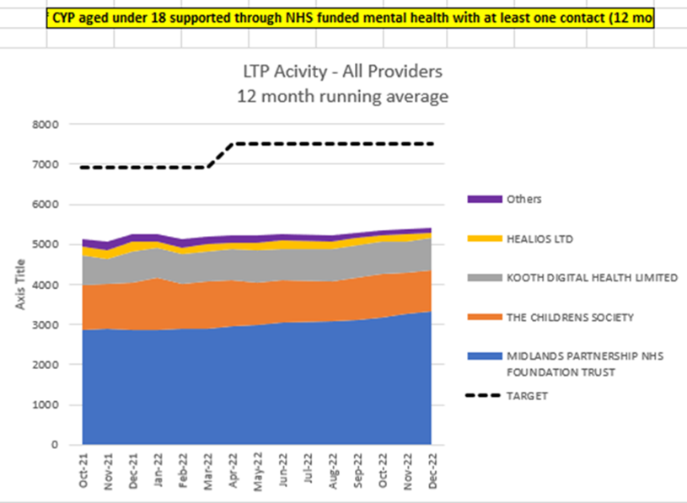
Access data

Slide 9
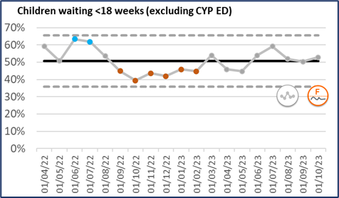
CYP Waiting Times
We have steadily reported on average over the past 18 months, seeing around half of children within 18 weeks (excluding referrals for eating disorders, which are expected to be seen within 4 weeks).

Slide 10
Waiting times
Waiting times vary, depending on what a Child or Young Person needs, the severity, and risk associated with their needs, and the variation in workforce with the correct skills to meet their needs.
Data is reported monthly through Contract Review Meetings to both the ICS and Local Authority. The table below shows the wait time by weeks as at the end November 2023.

Slide 11
Key Performance Indicators
100% of children and young people in crisis, receive face to face or telephone contact from a crisis response worker within four hours.
100% of children and young people receive initial contact within the required timeframe for CRHT crisis Urgent 72 hours.
Eating Disorders - 100% of CYP with eating disorder (ED) (Routine cases) referred with suspected ED, start treatment within 4 weeks of referral to ED services.
Eating Disorders - 100% of CYP with eating disorder (ED) (Urgent Cases) referred with suspected ED, start treatment within 1 week of referral to ED services.

Slide 12
Outcome measures
National Context:
From 1st April 2024, new reporting for NHSE will include Routine Outcome Measures as essential to count activity.
Local MPFT Data:
5,137 Children and Young People have completed Routine Outcome Measures between 1st April 2021 and 31st October 2023
61.75% of measurable results (paired outcomes) saw a general improvement
20.35% of measurable results (paired outcomes) saw a general decline
17.9% of measurable results (paired outcomes) saw no change
National Benchmarking:
“Approximately half of those who access child and adolescent mental health services do not show measurable improvement in symptoms.” (Bear 2022)

Slide 13
The local offer
The section give an overview of what is offered across Shropshire, Telford and Wrekin using the i-thrive model

Slide 14
The Mental Health Partnership
Children and Young People

Slide 15
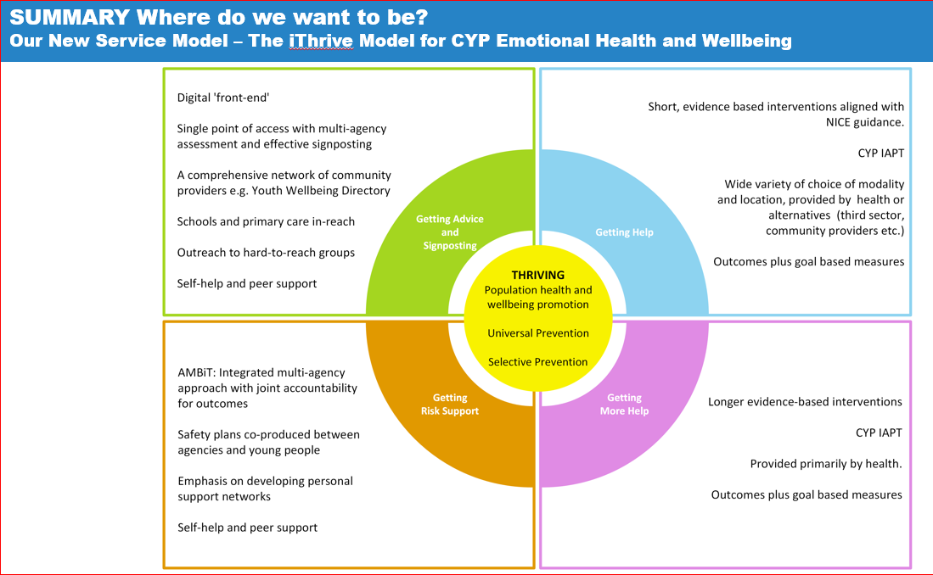
The local offer:
Thriving | Advice & Signposting | Getting Help | Getting More Help | Getting Intensive help
Community promotion and prevention | Consultation and advice | Core range of interventions delivered online and face to face | Specialist interventions provided by a multi-disciplinary team | Crisis support and home treatment for children and young people in crisis
Early identification and intervention via community, education, drop in and peer-led interventions, | Consultation regarding presentation of difficulties, advice regarding help and signposting to most appropriate help and intervention | Time limited, goals focussed evidence-based interventions in collaboration with children, young people and their families or carers e.g. treatments and interventions for mood and emotional disorders, routine assessments for behavioural presentations, parenting support | Complex care, often intensive and ongoing requiring different Bee U Specialist workers for severe and enduring presentations e.g. treatment for eating disorders, complex trauma, complex neurodevelopment and other complex presentations | Intensive short-term packages of interventions for acute, serious and life-threatening presentations
Bee U Beam Bee U Kooth 0-19 healthy child programme | Bee U Specialist 0-19 healthy child programme Anna Freud in schools Mental Health Support Teams (in selected schools across the county) | Bee U Healios Bee U Kooth Bee U Specialist | Bee U Specialist | Bee U Specialist Specialised Commissioners WM Provider Collaborative
 | Integrated Risk Support Working with our most vulnerable children across all agencies,, wine children are known to more than one service including mental health e.g. Looked after children, Children in Need, Children with Special Educational Needs, Children who are at risk of or have offended, Children requiring safeguarding
The i-Thrive model has been adapted locally and the table show how current service map against the model.

Slide 16
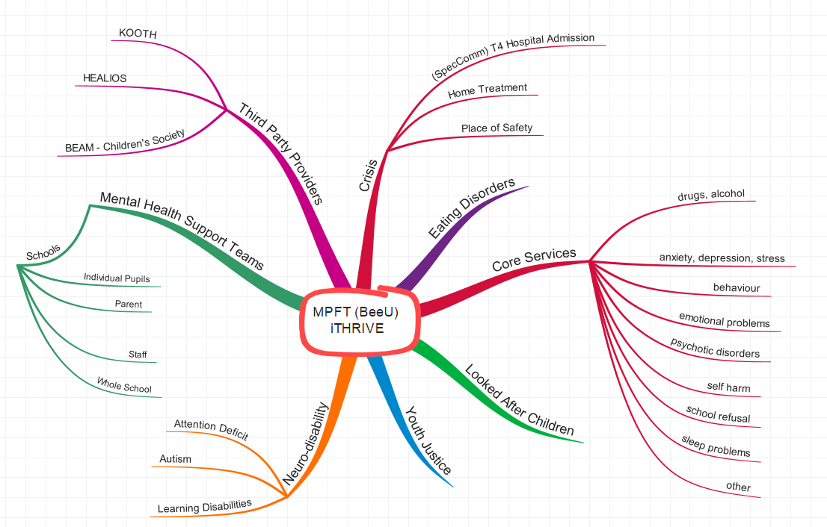
ICB Commissioned Services:

Slide 17
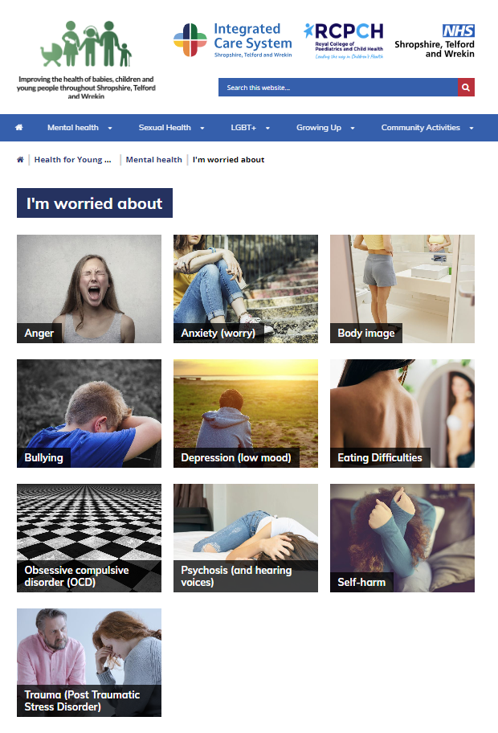
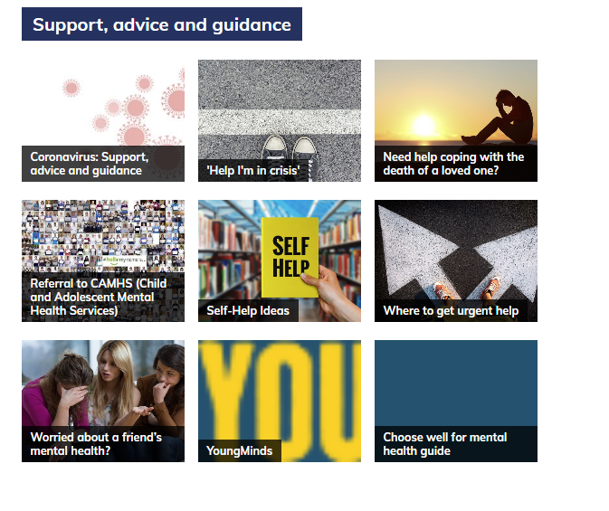
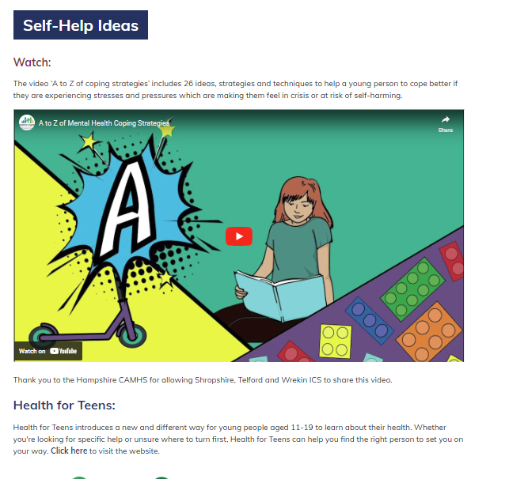
Getting Advice:
Healthier Together
Healthier Together is an initiative developed by Shropshire, Telford & Wrekin.
Healthier Together provides advice for parents, young people and pregnant women, as well as clinical resources to support healthcare professionals – which means that your child can receive consistently high-quality care, irrespective of which healthcare professional they see.
As a parent, career or guardian, you'll find clear information on common childhood illnesses for both physical and mental health, including advice on what 'red-flag' signs to look out for, where to seek help if required and how long your child's symptoms are likely to last.
The Healthier Together programme is a community initiative that relies upon patients and healthcare professionals working together to improve how local healthcare is delivered.
Family Connect offers information advice and guidance within Telford & Wrekin Local Authority as does the Local Offer.
Support, advice and guidance (stw-healthiertogether.nhs.uk)

Slide 18
Getting Help
Shropshire place:
Early health hubs - These hubs are facilities for co-ordinating early help services, providing children, young people and their families with help and support in times of need. They bring together services, such as family support, parenting support, health and voluntary sector partners and our local schools.
Strengthening families - It aims to support families who might need extra help to be happy, healthy and safe. This means services working together to provide families with the right support at the right time.
Voluntary sector support available at place including - Survivors of Bereavement by Suicide (SoBS), Shropshire Mental Health Support
Telford & Wrekin place:
Family Hubs opened in Telford & Wrekin – they are one-stop centres where families can get free information, guidance and support on infant feeding, mental health, healthy lifestyles and many other services.
Year of Wellbeing for Children & People launched in October 2023. The campaign aims to encourage young people across the borough to take action to enhance their wellbeing, through simple, small changes to their everyday life.
Family Safeguarding Model take whole family approach and includes MH practitioners in the team.
Voluntary Sector support available at place including Recharge, SmashLife.

Slide 19
Department of Education:
Mental Health Lead Training
98 Mental Health Leads have been trained across Shropshire, Telford & Wrekin since Spring 2022.
The training has led to two certificates:
Advanced Designated Mental Health
Level 4 Certificate in Mental Health Aware Leadership
The course is over 3 days and focuses on the following three areas:
Developing the universal and targeted support offer
Identifying mental health and wellbeing needs and monitoring the impact of support
Approaches to plan and lead change aligned to the work of your designated safeguarding lead/special educational needs co-ordinator
Engaging students and developing positive relationships with parents, families and carers:
The key area on Day 1 is all about the culture ad ethos in the school and how others manage the change the process.

Slide 20
Future in Mind
Future in Mind (FIM) was established in Telford & Wrekin in November 2016. There are currently 65 participants, with secondary schools being less engaged in the programme. In Shropshire, the programme is in its 3rd year, with 65 participants. There is a better balance of primary and secondary but there is more work to do with recruitment. The purpose of FIM was to address the Green Paper and ensure that schools were supported, understanding and recognising different mental health illness and providing non-clinical interventions to support this. Schools appreciate the support, and all delegates receive three full days of training and weekly e-mails with a range of support and information about what is happening locally and nationally. The focus for the three days is partner driven and addresses what schools are finding the most challenging at present. For 2023-2024, all schools have identified EBSA and the need to have CBT strategies to support children and young people. Telford & Wrekin have selected understanding and meeting the needs of children with a range of different behaviour presentations and Shropshire have selected a full day’s training on anxiety.

Slide 21
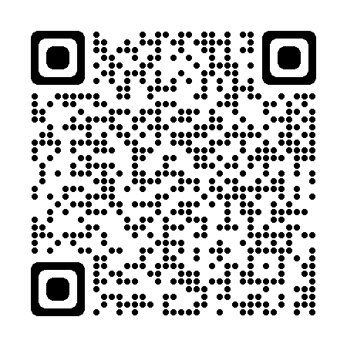
Supporting Services
BEAM
Shropshire, Telford and Wrekin wellbeing service
We are an emotional health and wellbeing drop-in service for young people under 25 years old who are registered with a GP in Shropshire, Telford or Wrekin.
Our team of experienced wellbeing practitioners and volunteers will listen to whatever is troubling you.
https://www.childrenssociety.org.uk/information/young-people/well-being/services/beam-shropshire-telford-wrekin
Kooth.com is a free, safe and anonymous website for young people living in Shropshire, Telford and Wrekin aged 11-19. You don’t need to be referred or have an appointment.
Kooth provides an anonymous 24-hour online service, 365 days per year, offering peer support, self-help and trained and qualified counsellors available to talk to online.
Offers online Cognitive Behavioural Therapy (CBT) to help CYP make sense of and work on their thoughts, feelings and behaviours, or Goal Based Intervention (GBI) to improve their emotional coping skills, boost resilience and achieve their goals. Support is delivered in a variety of ways, including video sessions with a clinician, text-based communication or self-care exercises on the ThinkNinja app.

Slide 22
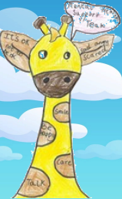
Mental Health in Schools
Shropshire, Telford and Wrekin have 4 operational MHST’s, covering:
South Telford
North Telford
North Shropshire
Shrewsbury and Oswestry
There are plans to expand further with a team (South Shropshire) starting January 2024, and a further team agreed for January 2025.
The MHST’s have not contributed to the ‘Access Target’ as much as was expected, and the MHST’s are working with all schools on an action plan to increase their activity levels, and the numbers of students in those schools, who can be supported to access evidence-based interventions to support their emotional wellbeing and mental health.

Slide 23
Suicide Prevention
There is a new suicide prevention strategy in place.
Locally we have developed Real time surveillance.
Suicide Prevention Awareness 2.5 hours webinar.
Suicide First Aid: Understanding Suicide Intervention 7 hours classroom/webinar
Develop referral pathway into services from A&E.

Slide 24
Getting more help
Eating Disorders
CYP Eating Disorder Services has had additional investment, and the staffing compliment has doubled from 2 years ago. Increasing specialism and ability to respond in a timely manner to specialist referrals and needs.
The waiting time standards for CYP Eating Disorders is met the majority of the time (target 95%).
There is ongoing work in regards data quality with NHSE to ensure local reporting matches national data sets.

Slide 25
Getting risk support:
CYP Crisis Team
The model to provide Children and Young People with 24/7 access to Mental Health Support if they present in a Crisis is under review, with a full options paper and joint impact assessment going through rigorous governance into 2024.
Reasons for this are:
The move to offer a 24/7 model was taken quickly in response to the Covid19 pandemic and coincided with regulations imposed on Shrewsbury and Telford Hospitals Trust by the CQC, preventing them for admitting patients with mental health (only) concerns to their departments. It was based on limited data and information about the demands or expected levels of need. We now have data that shows a reduction in referrals for CYP Crisis Services, since the 24/7 model was established.
Staff vacancies and staff sickness led to periods of ‘business continuity’ which meant 24/7 provision was not always possible by children’s mental health staff crisis team, although there was access for CYP to be seen by adult mental health practitioners.
Accessed the IROC service to prevent Tier 4 admission with good outcomes to date.

Slide 26
What’s next
This section details what the STW ICB system will be leading during 2024/25

Slide 27
Planned for 2024/25
Commissioning:
Mapping of services
Review of all services
Engagement with public
Financial Pressures
Work within available funding
Joint Commissioning for CYP Neurodevelopmental (ND) Pathways
Develop commissioning intentions regarding Children’s ND pathways
Work with partners and service users to coproduce a pathway including diagnosis and pre and post support/services
To understand if an all-age pathway to ensure transition is not an issue/gap

Slide 28
Planned for 2024/25
Work to reduce waiting times with the following ambitions:
Core BeeU seen within 18 weeks of referral (currently 7 months)
CYP ND assessments seen within 18 weeks– current CYP wait times are approximately 40 weeks to reduce waits as part of ND pathway review
Increase in Mental Health in School Team (MHST) –
Locally there are now 5 teams across STWICB, it has been agreed by NHSE that we will get another team in wave 12 – training to commence January 2025. The MHST are currently reviewing their locally model and learning from other sites.

Slide 29
Planned for 2024/25
CYP MH Governance
To develop the CYP governance for the system to ensure:
Assurance
Robust monitoring and data
Shared pathways across the system
System understanding of need for CYP across the system
Ability to escalate and mitigate against risks

